Slide 1
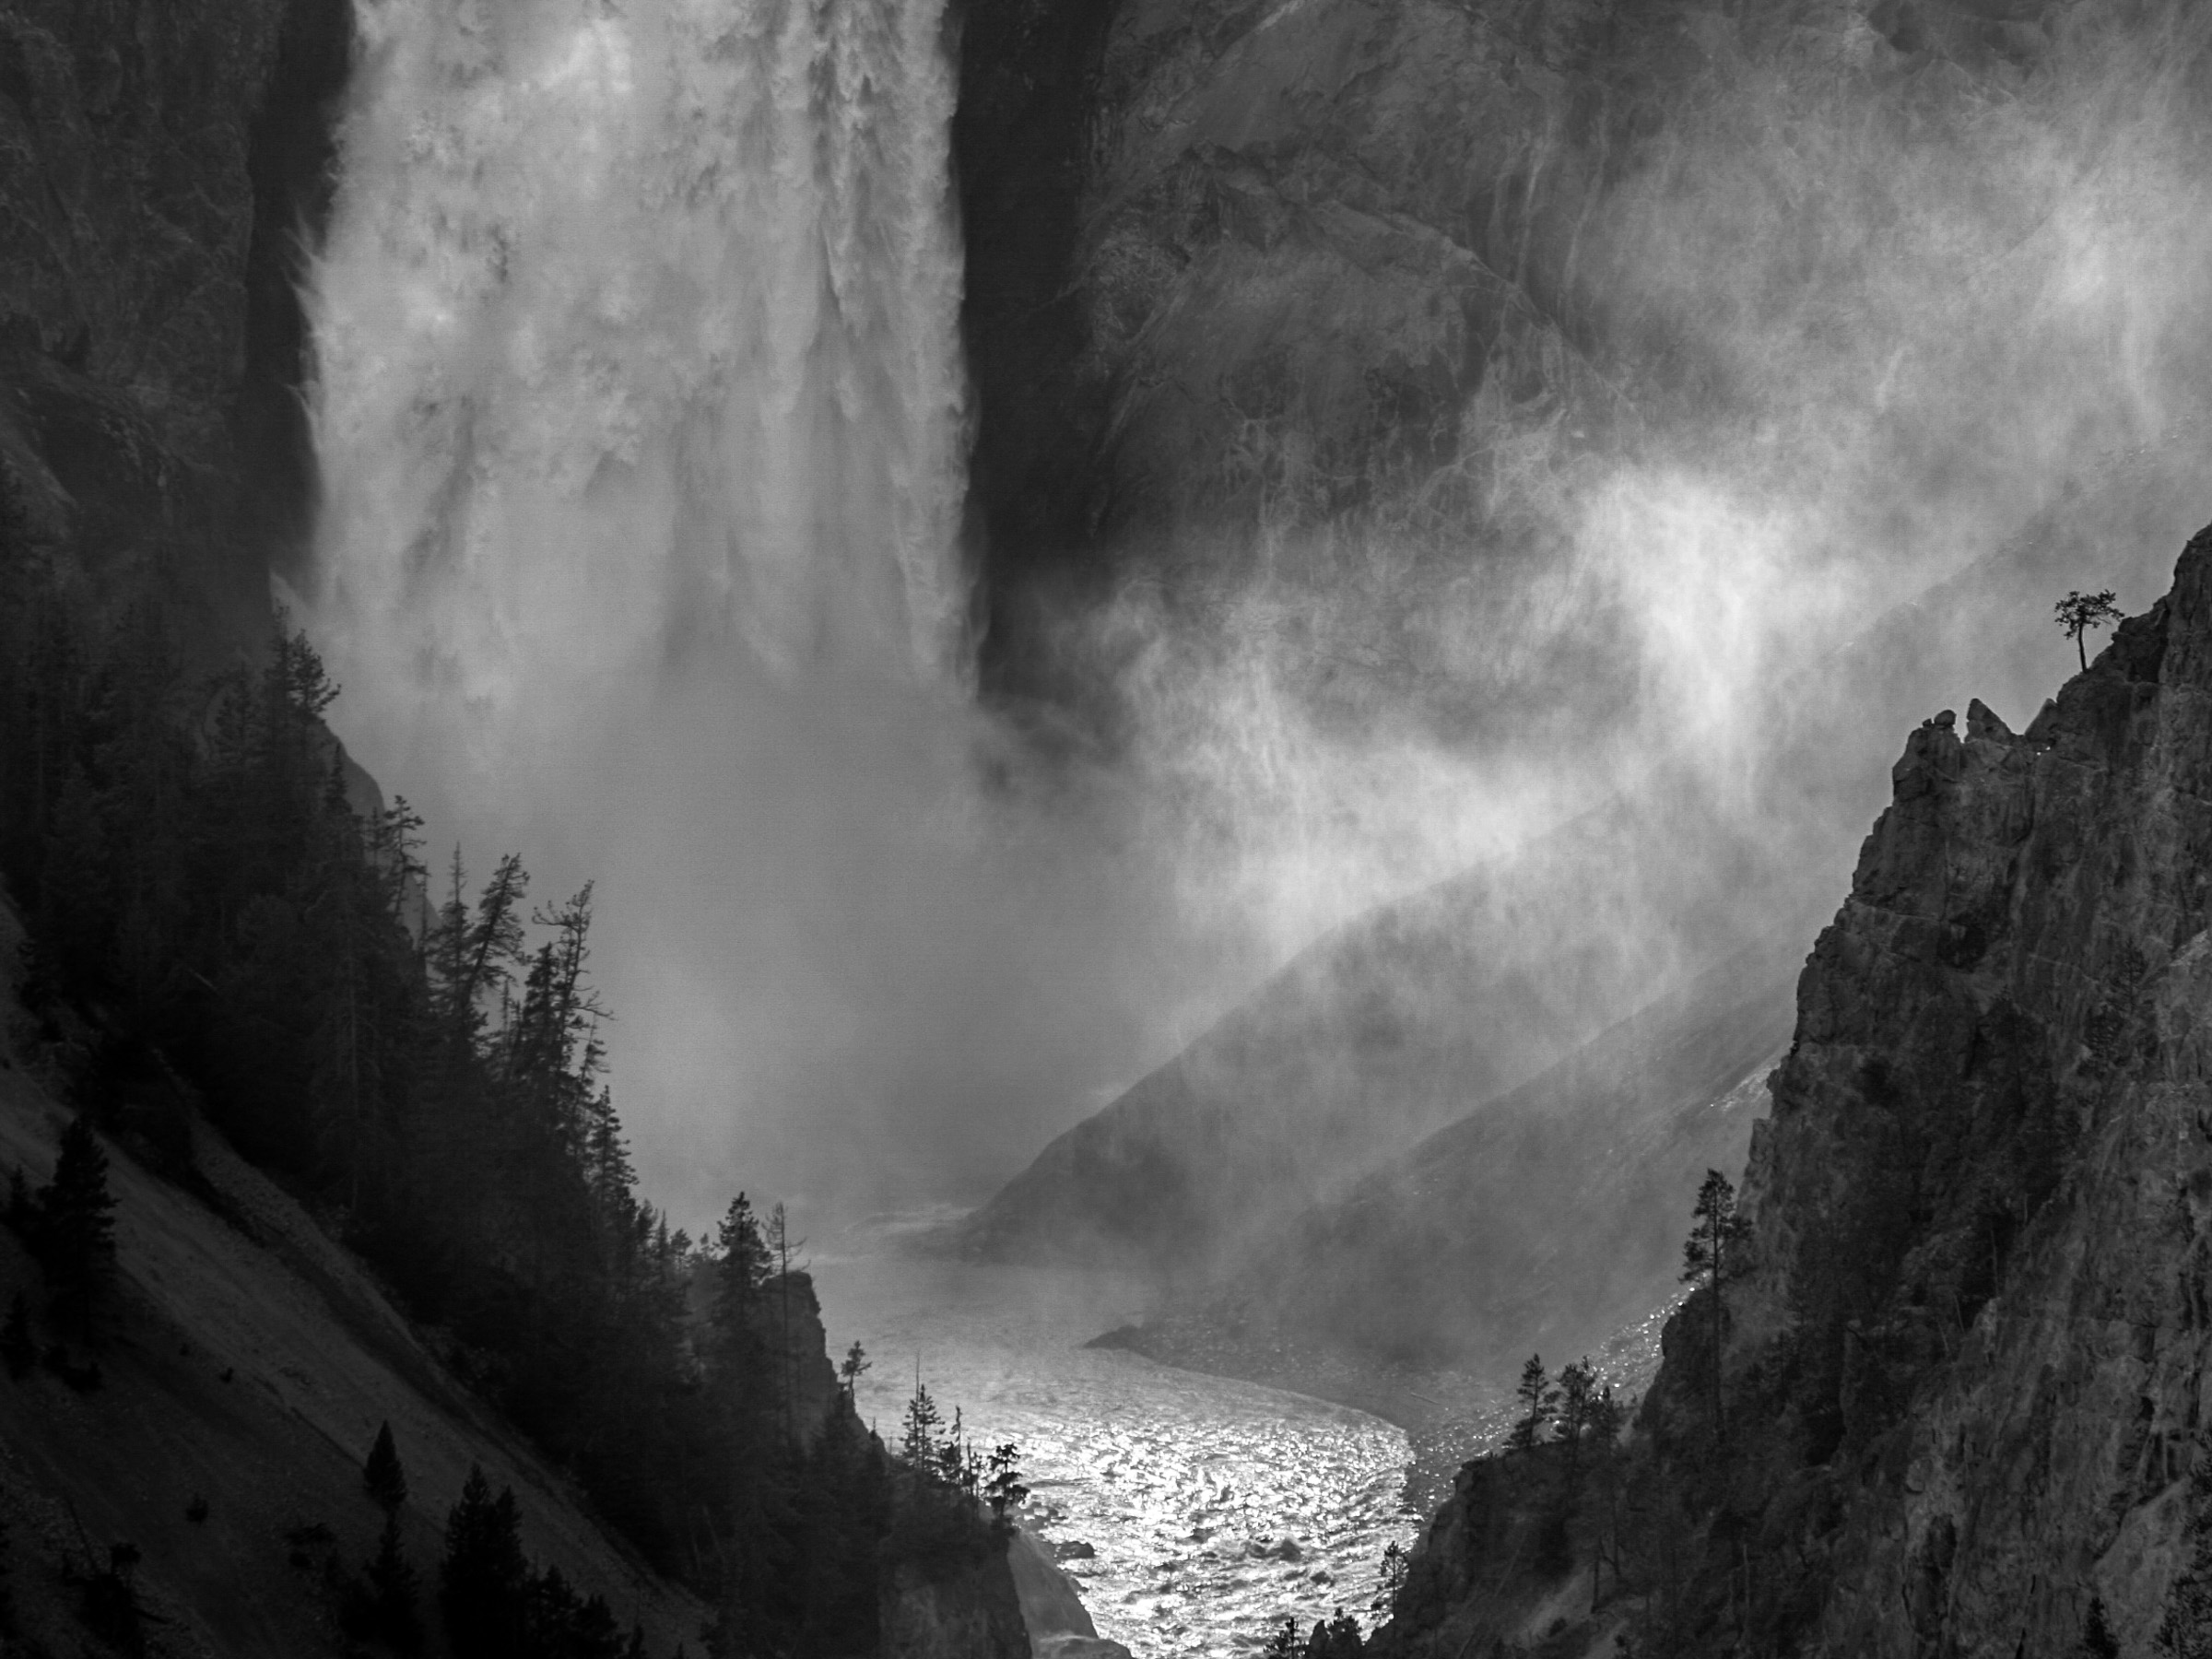
Processes in Protoplanetary Disks
Phil Armitage
Colorado

Slide 2
Processes in Protoplanetary Disks
Disk structure
Disk evolution
Turbulence
Episodic accretion
Single particle evolution
Ice lines and persistent radial structure
Transient structures in disks
Disk dispersal

Slide 3
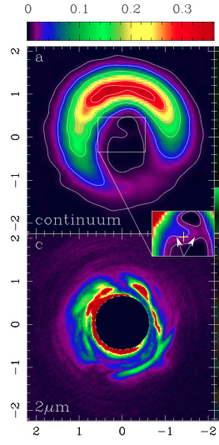
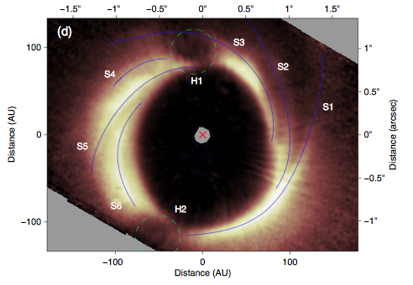
Avenhaus et al. ‘14
Observe rings, spiral arms, other
non-axisymmetric structure in
disks. What planetary and non-
planetary processes responsible?
Casassus et al. ‘13

Slide 4
Two possible types of structure:
persistent structures caused by physical changes
in the disk tied to specific temperatures, changes in
ionization level, planetary perturbations
- ice lines, edges of dead zones, planetary gaps
transient structures that could form anywhere in
the disk
- vortices, zonal flows
…might be thought of as “inverse cascade”
consequences of turbulence

Slide 5
Ice lines
Water snow line: T = 150-170 K, signature in the asteroid
belt at r ~ 2.7 AU
CO snow line: T = 20 K, around 30 AU corresponding to the Solar System Kuiper Belt
Multiple physical processes:
diffusive outward flux of vapor
(Stevenson & Lunine ‘88)
feedback on ionization state
(Kretke & Lin ‘07)
opacity feedback on thermal structure
(Hasegawa & Pudritz ‘11)

Slide 6
Physics at an ice line
vapor diffuses upstream
down concentration gradient
sublimate to vapor,
which flows in at same
speed as gas (it is gas!)
ice particles drift inward
at faster than gas inflow
speed (radial drift problem)
…and recondenses into (or onto)
ice particles just outside snow line
Net effect: vapor diffusion leads to an overdensity of
solids in the vicinity of the ice line (Stevenson & Lunine ‘88)

Slide 7
Physics at an ice line
T
vapor
Phase boundary given by
Clausius-Clapeyron equation:
L is specific latent heat
ice
P
If the actual vapor
pressure in the disk
is less than the equilibrium vapor pressure given
by phase diagram, ice will vaporize
if greater, vapor condenses

Slide 8
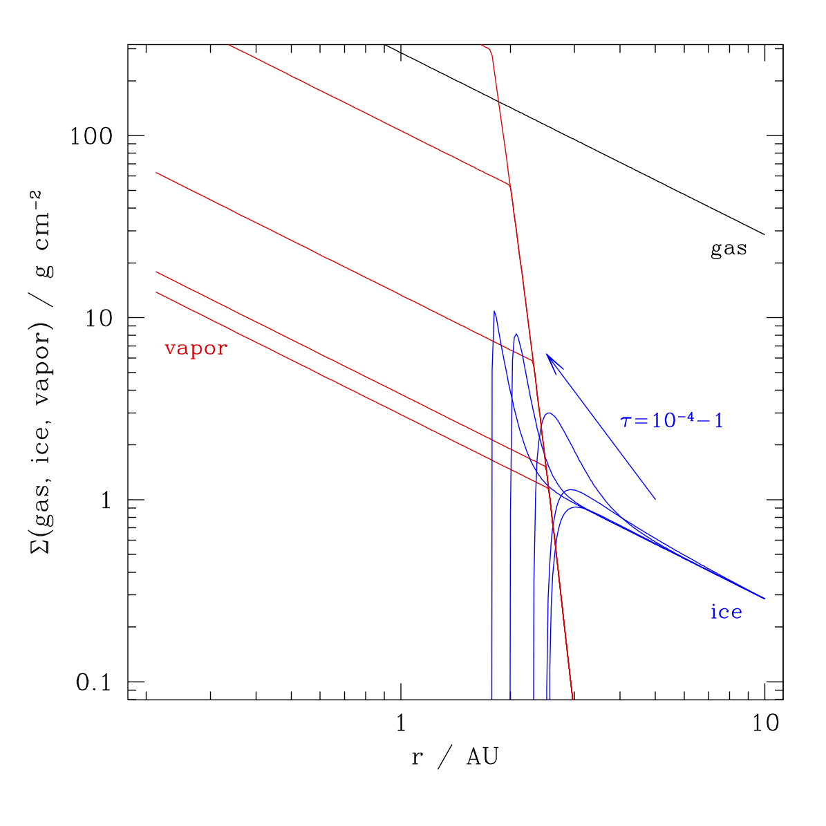
For icy particles that
drift in rapidly:
can have high
vapor density
inside snow line
  (continuity)
overdensity of
solids outside from
diffusion + re-
condensation
1D model with radial drift, sublimation / recondensation,
turbulent radial diffusion

Slide 9
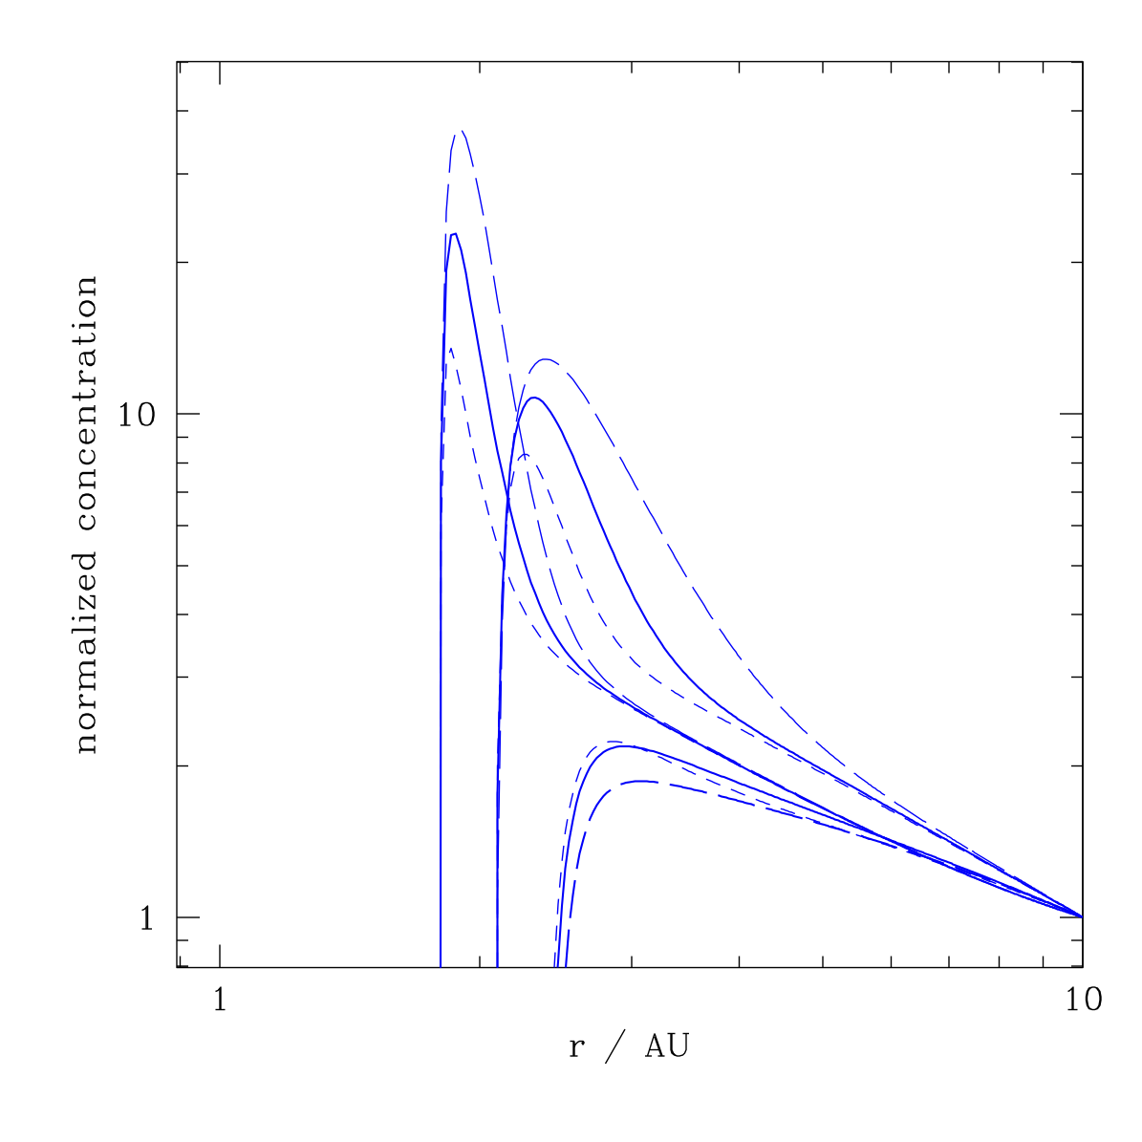
Stevenson & Lunine
‘88 and Ciesla &
Cuzzi ’06 argue that
solid over-density
outside snow line
ought to promote
planetesimal formation
there
Possibly a stronger
effect in “threshold”
planetesimal formation
models based on the
streaming instability

Slide 10
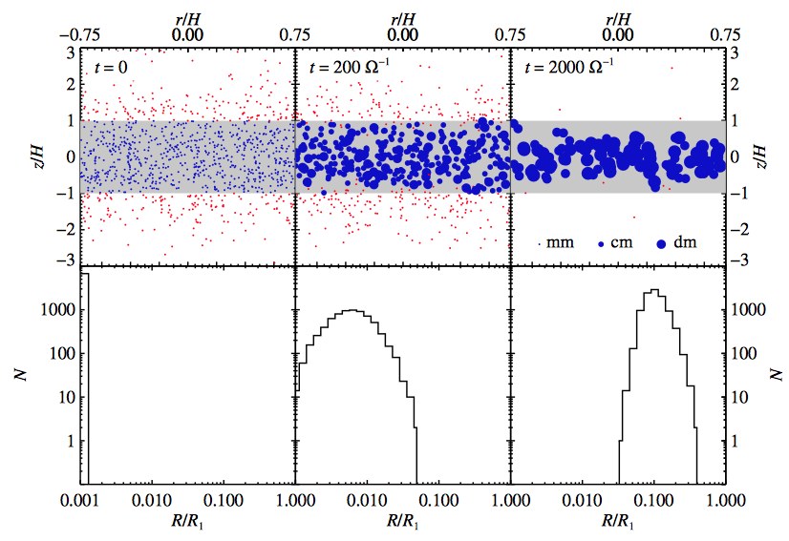
Ros &
Johansen
‘13
Condensation of vapor on pre-existing particles could
lead to rapid growth of particle size in same region

Slide 11
Particle traps
Radial drift – particle flow is toward pressure maxima
P
r
inward in a smoothly varying disk model
unaffected by diffusive snow line physics

Slide 12
Particle traps
Radial drift – particle flow is toward pressure maxima
P
r
Introduce axisymmetric local pressure maximum
in disk – convergent radial drift toward the location
of peak pressure… a “particle trap”

Slide 13
Where might traps form in disks?
Inner edge of a dead zone…
T ~ 10³ K
thermally
ionized,
α ~ 0.02
dead zone
α ~ 10⁻³
in steady state
thermal ionization exponential f(T), so expect sharp
transition
surface density scales as α⁻¹

Slide 14
Can model in 1D using equation for particle drift + turbulent
diffusion:
radial drift term, now
not a monotonic f(r)
if diffusion is present, term “particle trap” is
a misnomer
for any P(r) can find steady-state solution…
particle density builds up in “trap” until
dC / dr large enough for particles to diffuse
through the trap and into inner disk

Slide 15
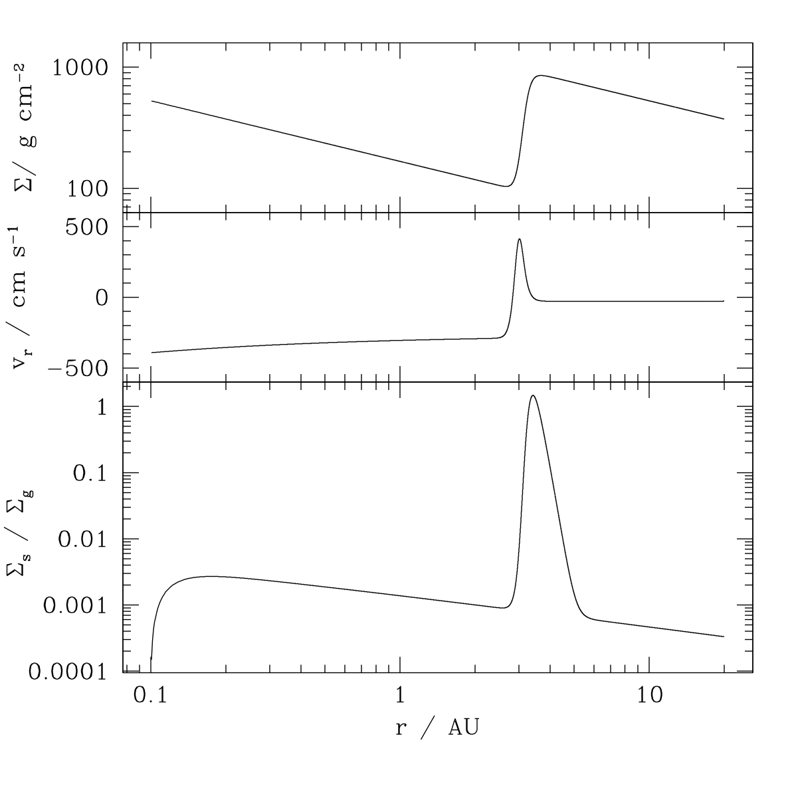
Example for
a hypothetical
trap at the
snow line
jump in Σ producing
local pressure maximum
radial drift velocity is
positive at edge of trap
can obtain a steady state,
but with a large concentration
of particles in the “trap”

Slide 16
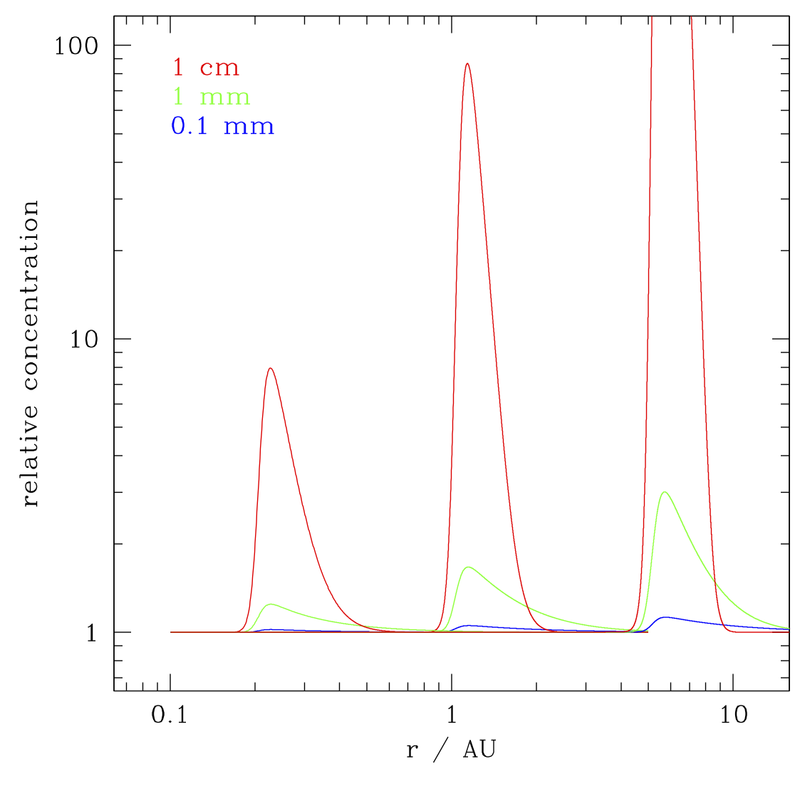
Degree of concentration depends on the particle size…
still an aerodynamic effect dependent on stopping time
concentrate
smaller mm
particles at
~10 AU and
beyond…
any traps in
outer disk
should be
directly
detectable
concentration
of cm and
larger particles
at inner dead
zone edge…
interesting
location for
close-in
super-Earth
planet
formation

Slide 17
Snow line particle over-density does not (in principle) require
any perturbation to the gas density
Particle traps at pressure maxima depend on P(r)
Are axisymmetric bumps in the surface density stable?
unstable to Rossby Wave
Instability if the vortensity
has an extremum (Li et al. ‘99)
(a more complete criterion involves the entropy gradient)
Type of inertial wave (restoring force: Coriolis force)
Roughly, need 10-20% variation in Σ over scales ~h

Slide 18
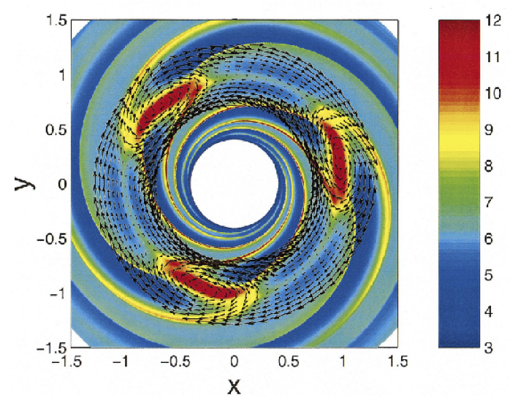
Ring-like structures cannot smoothly evolve into large,
radially narrow, over-densities
Rossby wave instability leads to the formation of
vortices at the edges of the rings
Li et al. ‘01
Armitage ‘13
Physics and outcome is very similar whether the cause of
the ring is a planet, or a sharp transition with some other origin

