Slide 1

Processes in Protoplanetary Disks
Phil Armitage
Colorado

Slide 2
Processes in Protoplanetary Disks
Disk structure
Disk evolution
Turbulence
Episodic accretion
Single particle evolution
Ice lines and persistent radial structure
Transient structures in disks
Disk dispersal

Slide 3
Disk winds
Photoevaporation – basic physics
heat surface of disk to sound speed c_{s}
where c_{s} > v_{K}, gas is unbound
flows away from disk in a thermal wind
Naively:
gas escapes beyond
a critical radius

Slide 4
Photoevaporation – many variations on a theme…
Heating by central star:
External photoevaporation:
EUV radiation – hν > 13.6 eV
FUV radiation – 6.0 eV < hν < 13.6 eV
X-rays
FUV radiation from massive stars in a
cluster
Review: Alexander, Pascucci et al. ‘14, PP6

Slide 5
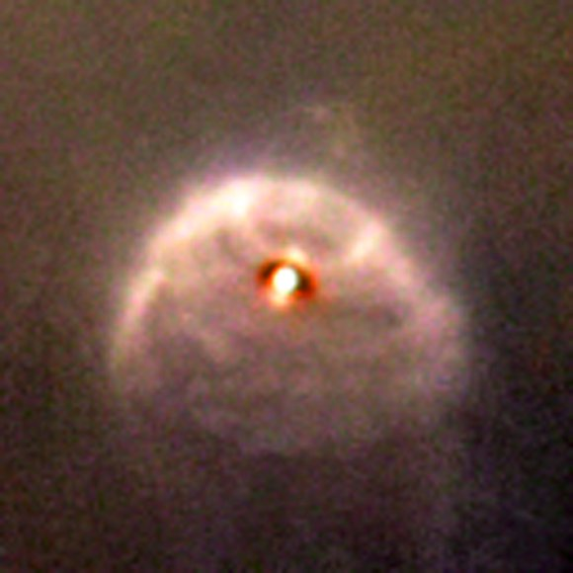
radiation from
massive stars
ionization front
FUV photoevaporated
disk wind flow
star + disk
HST / ACS – c.f. Ricci et al. ‘08

Slide 6
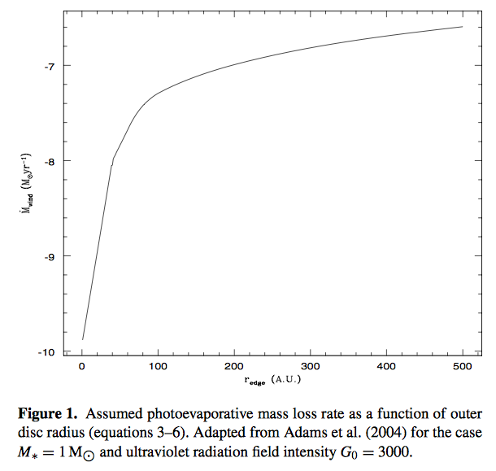
FUV radiation
fields in cores
of rich clusters
(e.g. Orion)
leads to rapid
mass loss if
disks are large
(r_{d} ~ 100 AU)
Clarke ‘07

Slide 7
Internal photoevaporation
radiation
thermal wind
heated layer
base density ρ
sound speed c_{s}
Rough estimate for mass loss rate per unit area:
Integrating over the disk surface gives total mass loss rate

Slide 8
Internal photoevaporation
Mass loss rate can be computed fairly easily for EUV case:
Font et al. ‘04
Mass loss rates are much harder to compute for the
FUV and X-ray cases, but are generally estimated to
be 1-2 orders of magnitude greater (Gorti & Hollenbach ‘09;
Owen et al. ‘10)

Slide 10
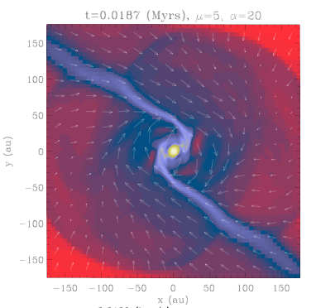
Disk winds
Thermal winds (photoevaporation) – no torque on the
remaining disk so affect evolution only via mass loss
Magnetic outflows can lead to a torque
Star formation simulations
suggest magnetic removal of
angular momentum can be
efficient (too efficient?!) during
initial collapse
Expect disks to retain some net
magnetic field after formation
Hennebelle & Ciardi ‘09

Slide 11
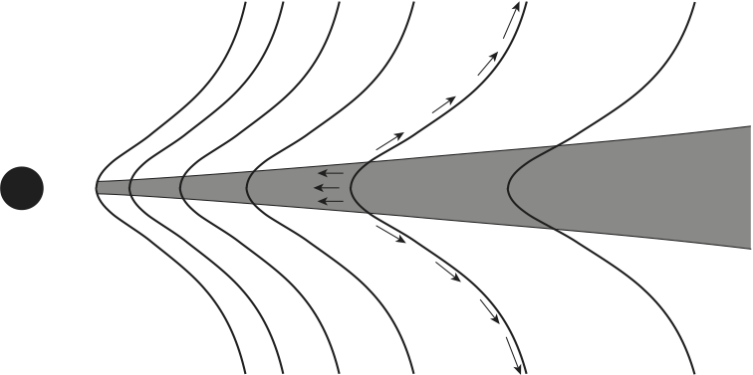
Disk, threaded by field
B, with magnetic wind,
density ρ(r,z), velocity
v(r,z)
Flow rotates ~rigidly provided:
Out to “Alfven surface”, outflowing gas gains angular
momentum, magnetic field exerts a torque on disk surface
At r_{A}, specific angular momentum:
If r_{A} >> radius where field line meets disk surface, a
small mass outflow can remove all the angular momentum
needed for accretion

Slide 12
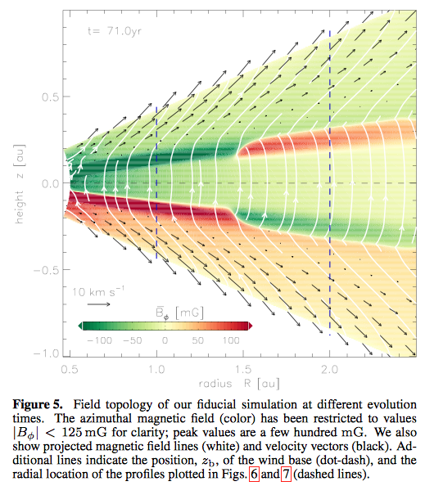
Gressel et al. ‘15:
disk models with
net field defined
via poloidal pressure
with respect to
gas pressure:
Here β_{z} ~ 10⁵
Observational
constraints on
this scenario?

Slide 13
If net field is important, what determines how B_{z} evolves?
Standard answer:
assume turbulence
provides both an
effective viscosity
and an effective
magnetic resistivity
r
h
Radial scale for accretion r >> h vertical scale for magnetic
reconnection… expect poloidal flux ψ to diffuse radially
faster than it is “dragged” inward (Lubow et al. 1994)
c.f. Guilet & Ogilvie ‘14
-ν/r
+η/h

Slide 14
Standard thinking:
magnetic winds may be strong during formation of
the protostar / disk phase
may occasionally prevent formation of a long-lived
disk at all (“magnetic braking catastrophe”)
most net flux subsequently escapes
a small net flux plays a role in stimulating MRI
later in disk lifetime
disk dispersal is thermally driven
…not obvious that MHD disk winds are unimportant
for disk dispersal phase (Armitage et al. ‘13)

Slide 15
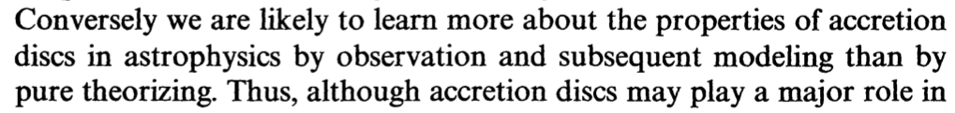
Testing theory
Pringle, ARA&A, 1981

Slide 16
Observational tests
Even known theory of disk instabilities is complex enough
that an entirely theoretical understanding of what’s going
on in real disks is not feasible
Observational tests come in two classes:
some mechanisms predict large-scale disk
structure (e.g. rings, vortices), that may be
directly observable
attempts to measure or constrain the small-scale
turbulent velocity or magnetic field

Slide 17
Components of the line-width in molecular lines from
protoplanetary disks
i
Keplerian rotation Thermal Turbulent
Small but potentially measureable
effect if systematics well-understood

Slide 18
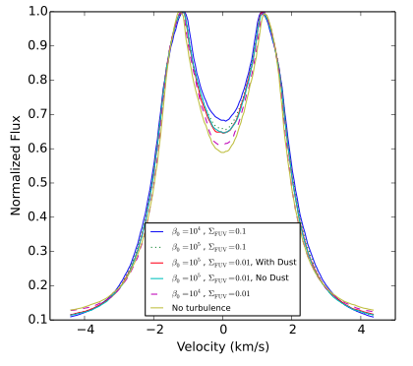
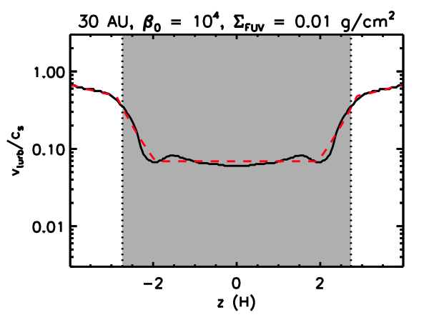
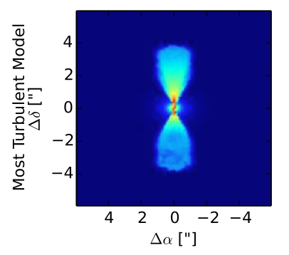
Different drivers of turbulence predict
different radial and vertical dependence
of the turbulent line-width
CO 3-2 line
center
Simon, Hughes et al. ‘15

Slide 19
“Boring” disks are interesting!
There must be a time prior to which planets have not
formed
is this time much earlier than conventionally
assumed (i.e. still in the Class I phase)?
suggested for HL Tau rings… this
is not a conservative interpretation!
If we can observe disks prior to planet formation
how quiescent are they?
are there large-scale structures that might be
essential ingredients for planet formation?
how turbulent, how much grain growth, etc?

