Slide 1
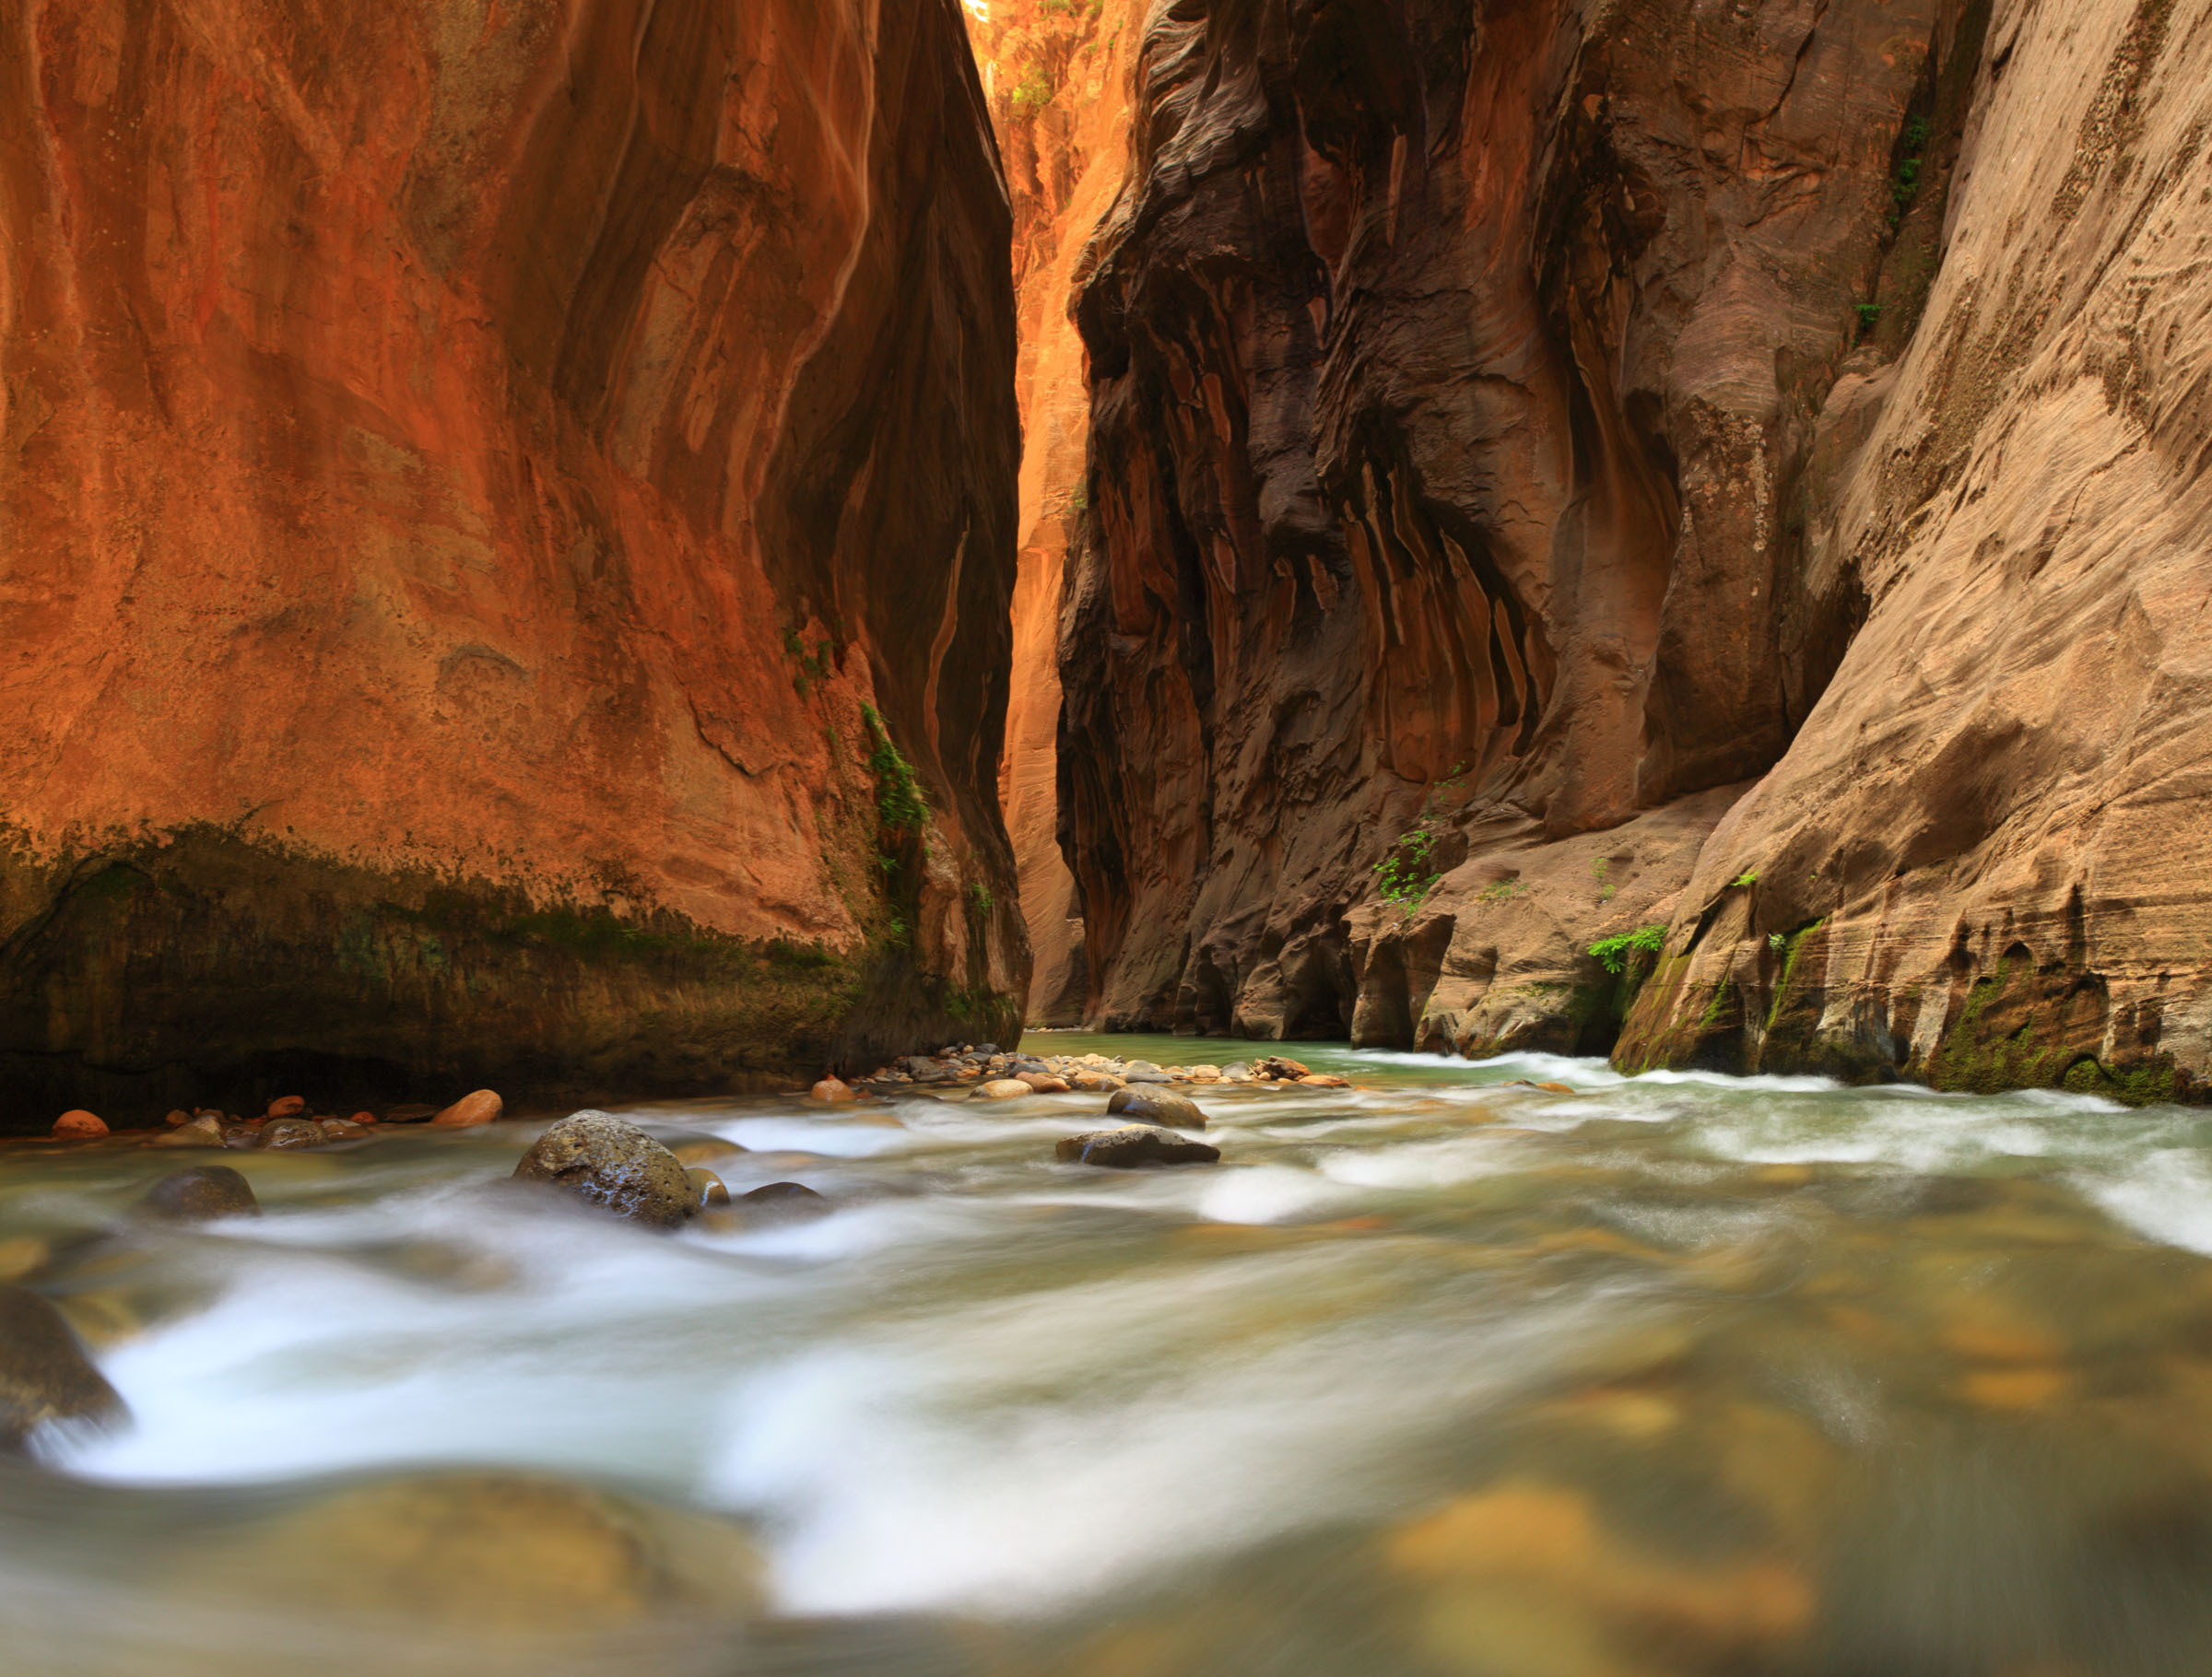
Processes in Protoplanetary Disks
Phil Armitage
Colorado

Slide 2
Processes in Protoplanetary Disks
Disk structure
Disk evolution
Turbulence
Episodic accretion
Single particle evolution
Ice lines and persistent radial structure
Transient structures in disks
Disk dispersal

Slide 3
What types of transient structures might form spontaneously
in turbulent disks?
General expectations
three-dimensional turbulence is described by a
cascade of energy from large to small scales,
where dissipation occurs
two-dimensional turbulent systems also support
an “inverse cascade”, where energy flows to the
largest scale accessible to the system
Protoplanetary disks are three-dimensional, but
strongly flattened… so not clear which regime is
better for gaining an intuitive understanding

Slide 4
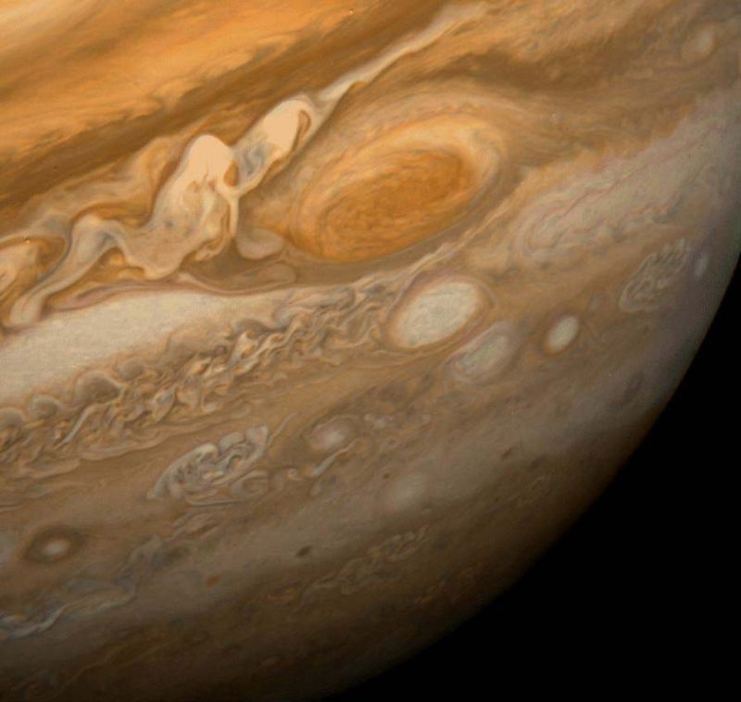
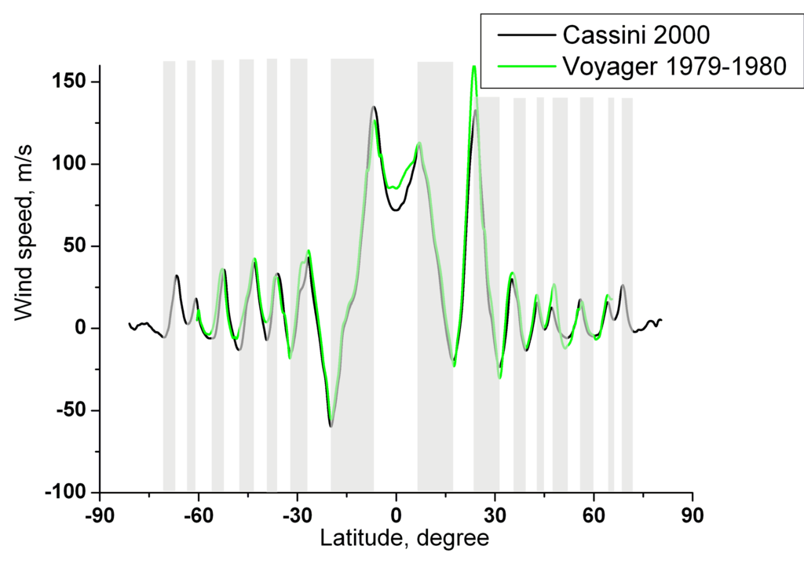
What types of transient structures might form spontaneously
in turbulent disks?
General expectations – in “nearly 2D” systems, form
Long-lived vortices
Zonal flows

Slide 5
Zonal flows
Johansen, Youdin & Klahr ‘09 found zonal flows in ideal
MHD simulations of disk turbulence
an inverse cascade leads to large-scale magnetic
field structures
the variation in the magnetic stress leads to peaks
and troughs in disk surface density
resulting pressure gradient is balanced by radial
variations in the azimuthal velocity
“geostrophic
balance”

Slide 6
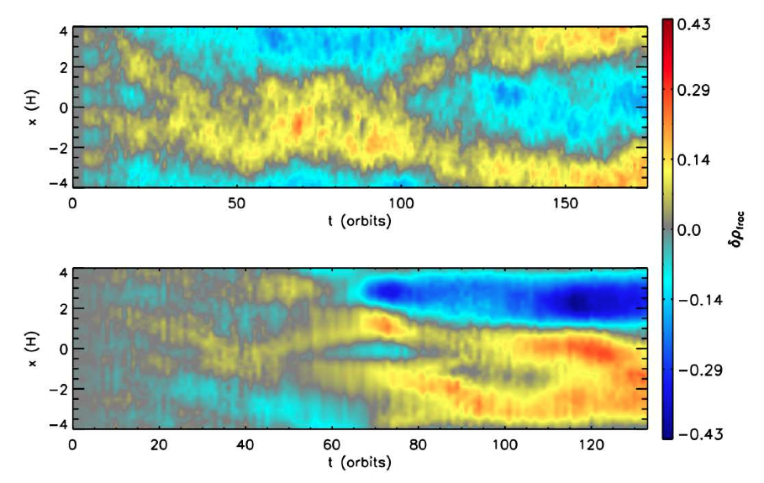
Appear to form generically in local simulations of MHD disk
turbulence
Ideal MHD
Disk model
at 30AU with
ambipolar
diffusion and
net field
Simon & Armitage ‘14
amplitudes of 10s of percent in Σ
lifetimes of 10s-100s of orbits

Slide 7
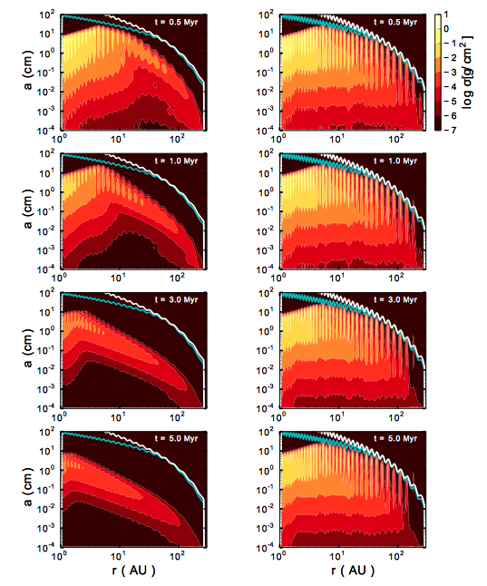
Zonal flows that are
strong enough to
trap particles could
assist in the collisional
growth of solids in
the outer disk
Pinilla et al. ‘12

Slide 8
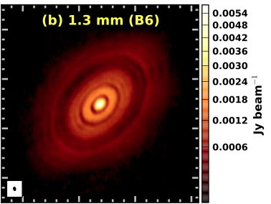
Axisymmetric ring-like
structures, in principle
detectable through
concentration of small
particles
Brogan et al. ‘15
Uncertainties
  what is the characteristic radial scale?
  in regions where ambipolar diffusion dominates,
  structures also depend on strength (and evolution?)
  of net magnetic fields threading the disk (Bai & Stone ‘14)

Slide 9
Vortices
Lesur & Papaloizou ‘09…
Several related issues concerning role of vortices in disks:
how to form them
their long-term stability and migration
efficiency at angular momentum transport
role in particle concentration

Slide 10
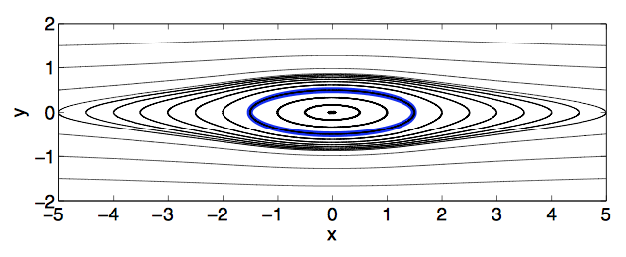
Vortices - rotating structures superimposed on the background
Keplerian shear. Simple model – Kida ‘81 solution
Velocity field for vortex core:
vorticity ω, aspect ratio χ, in
disk with background vorticity
S (Lesur & Papaloizou ‘09)

Slide 11
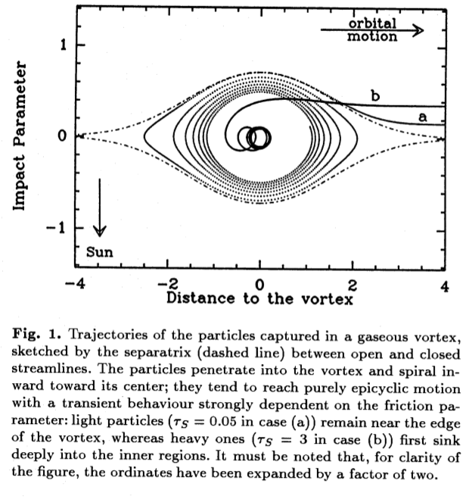
Only anticyclonic
vortices are
stable in disks
Particles tend
to spiral in toward
center of a disk
vortex (Barge &
Sommeria ‘95)

Slide 12
How to form vortices?
Rossby wave instability – this can be triggered by the
growth of a massive planet in a low viscosity disk
log Σ
formation of the gap
leads to potentially
unstable surface
density maxima at
the gap edges
log r
Any other process that leads to an unstable surface
density profile would spawn vortices in the same way

Slide 13
How to form vortices?
Baroclinic instability – in the disk context (not in atmospheres)
this usually refers to a non-linear entropy-driven instability that
drives vortices in disks with an appropriate S(r)
Requires entropy
profile that is
Schwarzschild
unstable
References:
Klahr & Bodenheimer ‘03;
Lesur & Papaloizou ‘10
Armitage, ARA&A ‘11

Slide 14
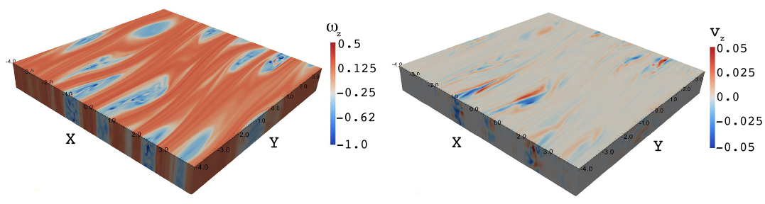
How to form vortices?
Lesur & Papaloizou ‘10
Pre-existing vortices – disk might form from clumpy
accretion and have vortices present at early times

Slide 15
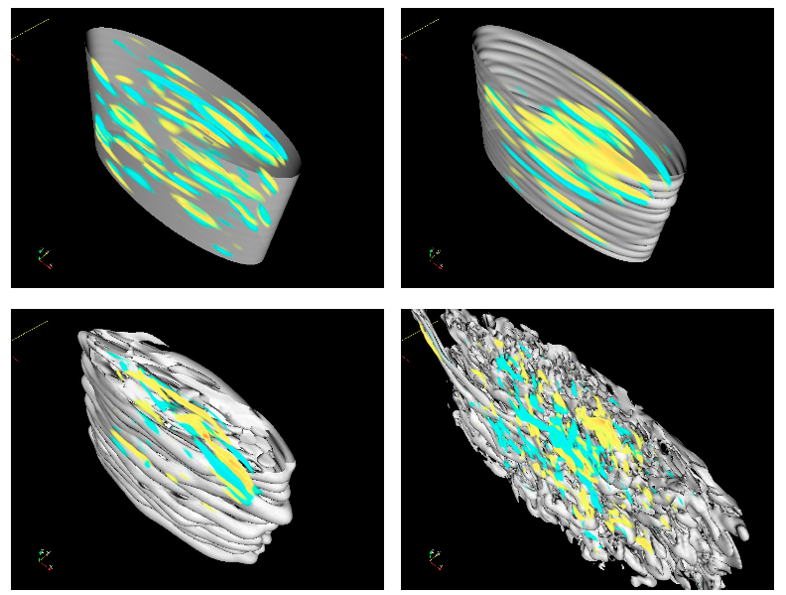
Stability of vortices
Vortices in inviscid, 2D gas disks are stable indefinitely
in 3D, destroyed by the
elliptical instability (a
resonance between the
turnover of the vortex and
epicyclic frequency)
vertical shear in the disk
may also affect vortices
Lesur & Papaloizou ‘09
However – growth rate of these instabilities is slow…
may take hundreds of orbits to grow to large amplitude

Slide 16
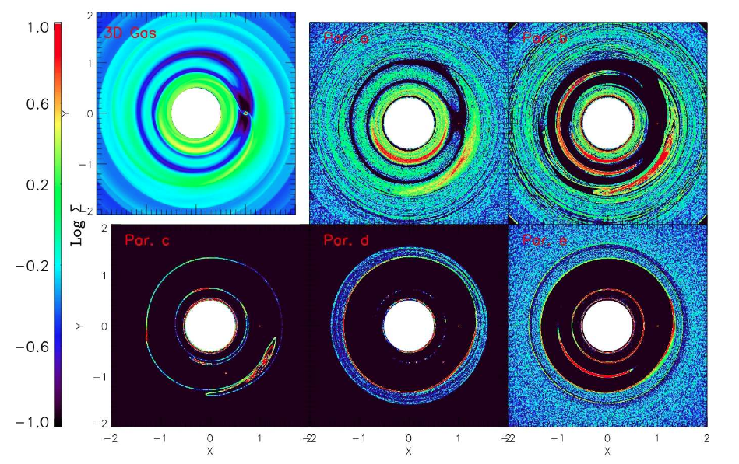
Trapping of particles
τ=0.02
τ=0.2
τ=2
Zhu et al. 14
Vortices strongly concentrate particles with stopping time τ ~ 1,
physical size of these particles depends on radius from star

Slide 17
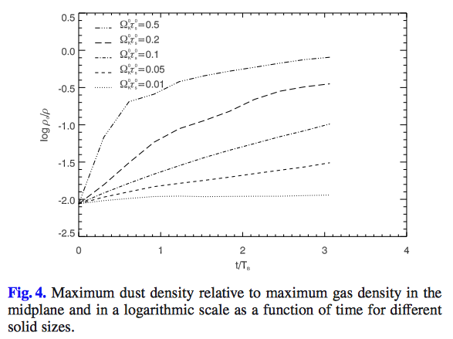
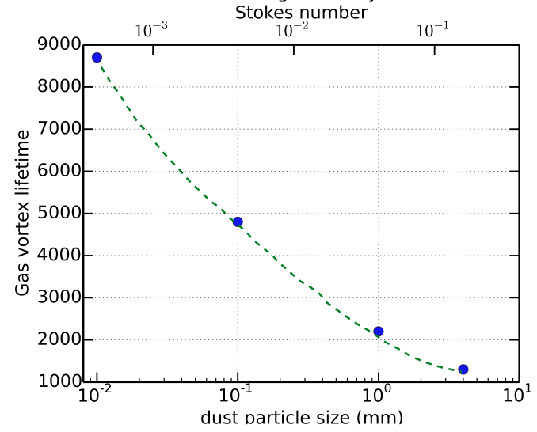
Meheut et al. ‘12
Fu et al. ‘14
Concentration of solids within vortex cores can be strong
BUT too high a density of solids leads to feedback on the
gas that destroys the vortex (Chang & Oishi ‘10)

Slide 18
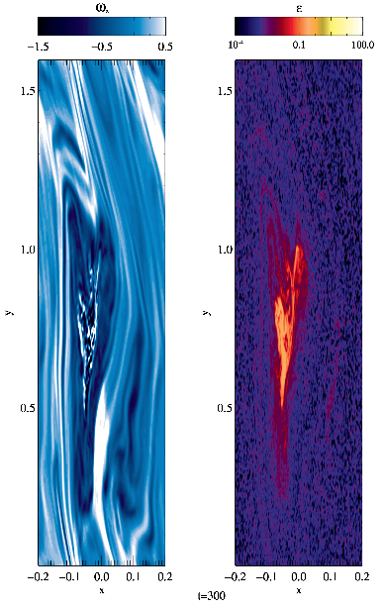
Possible scenario:
vortices form
particles with τ ~ 1
concentrate in core
streaming instability and
gravitational collapse
is triggered
before feedback of
solids on gas destroys
the vortex
Raettig et al. ‘15

Slide 19
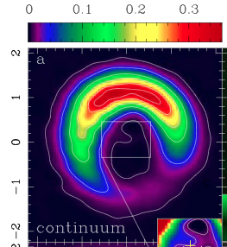
1. Application to asymmetry in transition disks
Interpretation of observed asymmetries
in transition disks as vortices trapping
particles is plausible
vortices in disks merge into a
single large vortex
a vortex in the outer disk traps
particles of ~mm size strongly
smaller dust particles are not
trapped
long time scales mean that
destruction processes do not have time to operate
Casassus et al. 13
Requires low viscosity (e.g. from ambipolar damping of MRI
turbulence). A planet would work to spawn the vortex, but
is not strictly necessary

Slide 20

2. A general role in planet formation?
For vortices to be important for all planet formation:
need vortices to be present and survive in the inner disk,
where time scales >> vortex destruction times
require ongoing source of vorticity
…which cannot be pre-existing planets
baroclinic instability is one possibility

