Slide 1
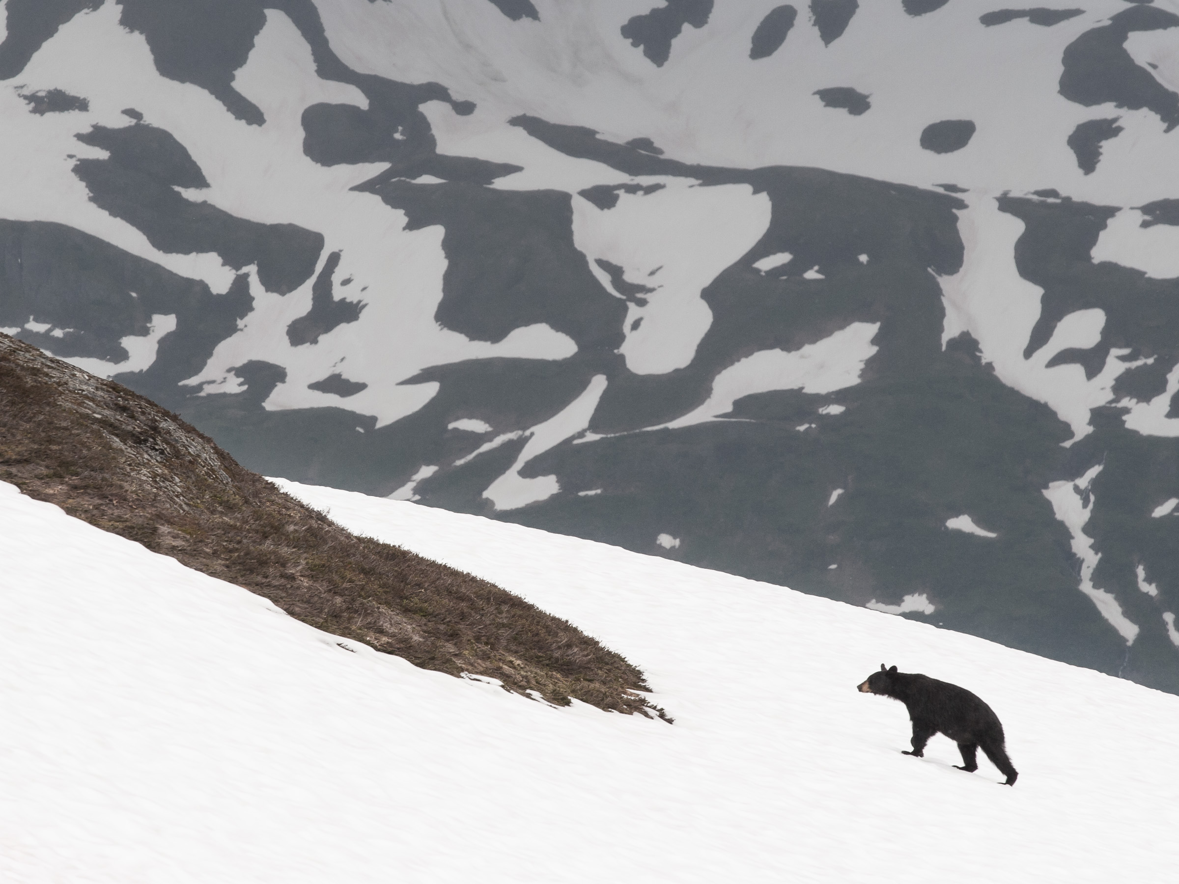
Processes in Protoplanetary Disks
Phil Armitage
Colorado

Slide 2
Processes in Protoplanetary Disks
Disk structure
Disk evolution
Turbulence
Episodic accretion
Single particle evolution
Ice lines and persistent radial structure
Transient structures in disks
Disk dispersal

Slide 3
Diffusive evolution
Start by considering evolution of a trace species of gas within
the disk (e.g. gas-phase CO)
Define concentration
Continuity implies:
If the diffusion depends only on the gas properties, then
the flux is:
advection with
mean gas flow v
diffusion where there
is a gradient in concentration

Slide 4
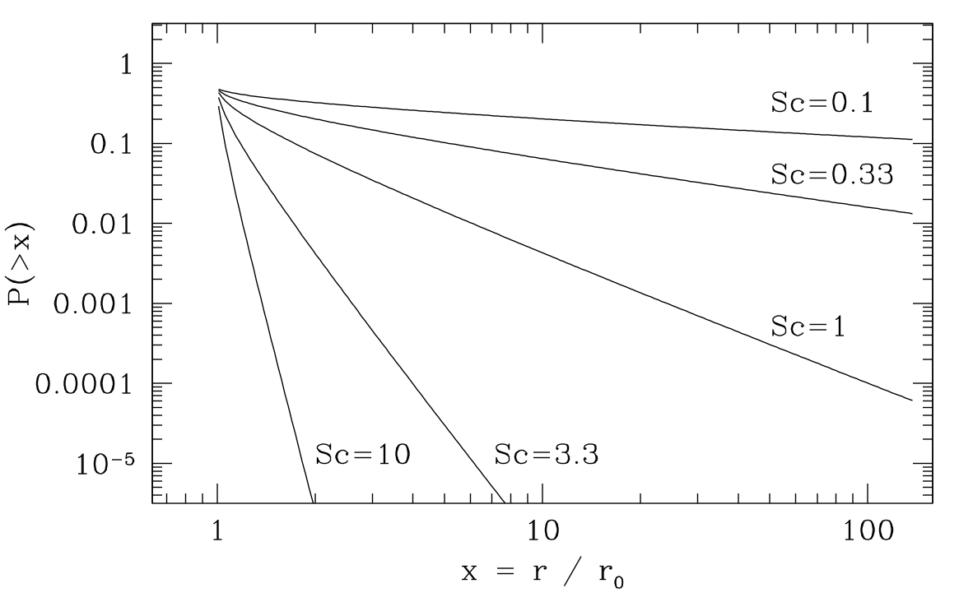
For an axisymmetric disk, obtain:
In a steady disk, v_{r} = -3ν / 2r. Solutions are very strongly
dependent on relative strength of viscosity and diffusivity:
Sc = ν / D (the Schmidt number)
For Σ ~ r⁻²,
maximum fraction
of contaminant,
released at x = 1,
that is ever at
radius x or larger

Slide 5
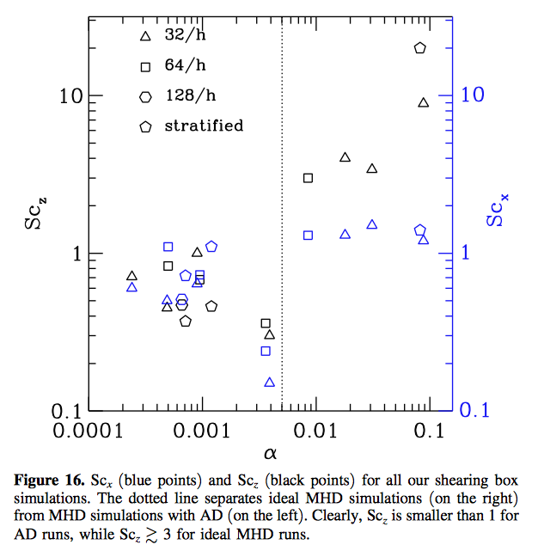
In ideal and
ambipolar MHD,
Sc for radial
diffusion (Sc_{x})
is generally
within factor
of ~2 of unity
Larger variations
for vertical
diffusion
Schmidt number
in Hall MHD?
Zhu et al. ‘15

Slide 6
Particle transport
How will this change if the trace species is a solid particle?
Very small particles will be so well-coupled as to behave
like gas. For larger particles:
radial velocity needs to
include the aerodynamic
drift term
diffusion is now not only different
(in principle) from gas viscosity,
but also size-dependent… large
particles’ inertia means they are
less affected by turbulence

Slide 7
Recap: aerodynamic drift occurs when dP / dr in the gas
disk leads to a background flow that is non-Keplerian
particle
equations
of motion
t_{stop} is the time scale on which aerodynamic
drag slow a particle moving relative to gas

Slide 8
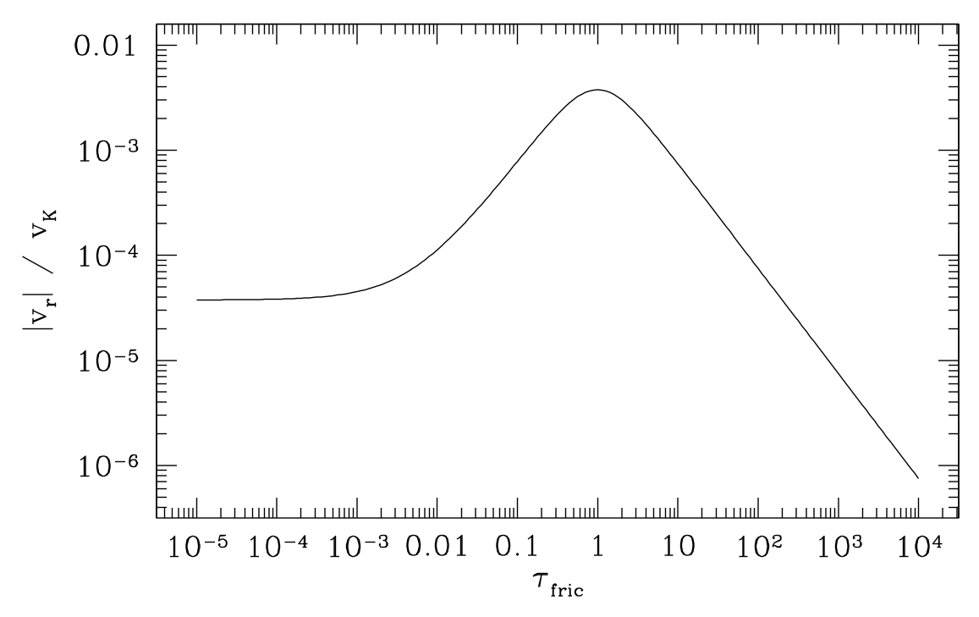
Recap: aerodynamic drift occurs when dP / dr in the gas
disk leads to a background flow that is non-Keplerian
e.g. (h / r) = 0.05,
α = 0.01 at 5 AU
Radial drift problem

Slide 9
Particle diffusion in turbulence
Describe turbulence as eddies,
time scale t_{eddy}, velocity δv_{g}
Make dimensionless
Consider particle, stopping time τ,
in limit τ >> 1 and τ_{eddy} << 1
In time Ω⁻¹, particle receives N ~ τ⁻¹_{eddy} kicks, each of
Add up as a
random walk

Slide 10
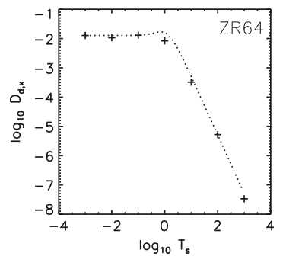
Distance travelled
This implies an effective diffusion coefficient
Since for small particles, D_{p} = D, generally,
Agreement with formal
analysis by Youdin &
Lithwick ‘07, which in
turn agrees with
measurements of
particle diffusivity
in (ideal) MHD turbulence
by Zhu et al. ‘15

Slide 11
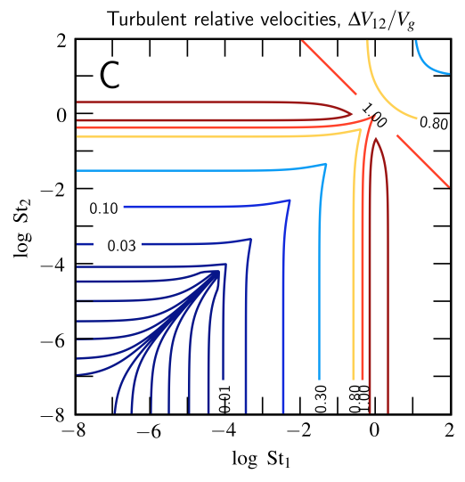
Same type of argument
gives the typical collision
velocities between particles
in turbulence (Ormel &
Cuzzi ‘07; see also Pan
et al. ‘14)
Note: large-scale nature of
turbulence is not so critical
here, expect fluid turbulence
to be good limit
General results:
  turbulent diffusion rapidly negligible for τ > 1
  for smaller particles, either turbulent component to
    collision velocities, or differential radial drift, can
    dominate depending on disk model

Slide 12
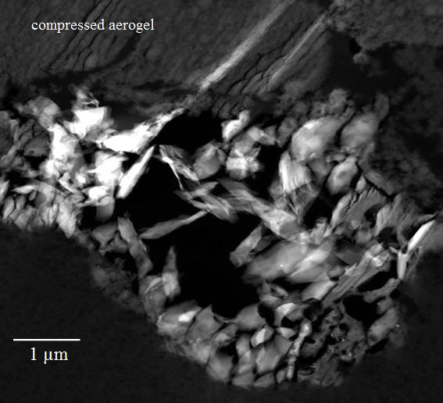
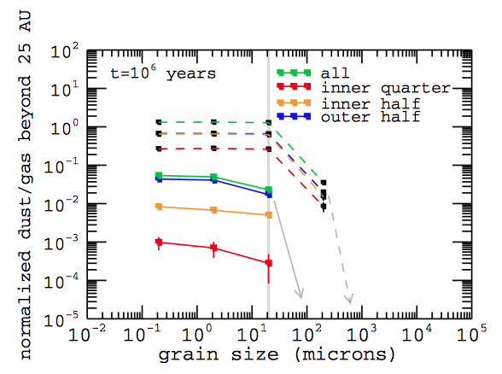
The Stardust problem
Brownlee et al. ‘06
Hughes & Armitage ‘10
Stardust mission recovered crystalline silicate particles
(processed at T > 10³ K) and CAIs from a Jupiter-family
comet… quite hard for “upstream” radial diffusion to
move such particles from inner disk to comet-forming region

Slide 13
Particle feedback
“Rule of thumb” – in many planetesimal formation models,
pre-requisite is local dust to gas ratio ρ_{d} / ρ ~ 1
solids are no longer trace contaminant,
feedback of particles on gas should not
be neglected
What is the equilibrium radial drift solution in this limit?
Is it stable?

Slide 14
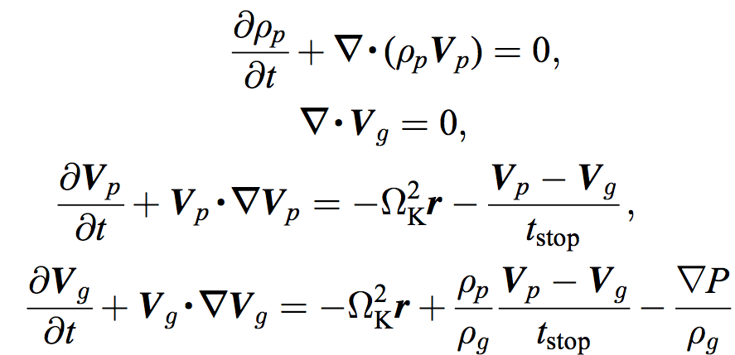
Equations for particle fluid interacting with an incompressible
gas disk via aerodynamic forces only:
e.g. Youdin &
Goodman ‘05
symmetric
momentum
exchange
Well defined equilibrium solution by Nakagawa et al. 86
Depends explicitly on relative densities of gas, solids… gas
has non-zero v_{r} in absence of angular momentum transport

Slide 15
Streaming instability
Nakagawa et al. ‘86 solution is linearly unstable – the
streaming instability (Youdin & Goodman ‘05)
Essential ingredients of the instability:
  dust pile-up in pressure maxima
  feedback on gas that strengthens the maxima
  rotation so centrifugal force can balance dP / dr
Even simplest description (assuming particles move at
their terminal velocity) is complex. Growth rate depends
on the stopping time τ, mass fractions in solids and dust

Slide 16
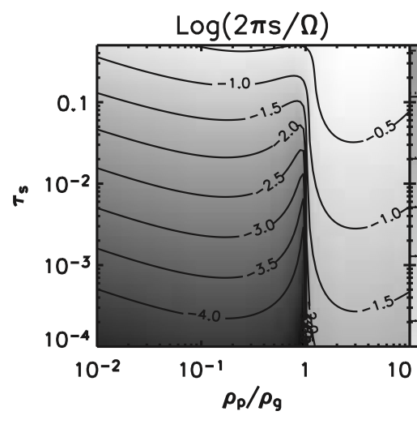
Growth rate of streaming
instability as function of
particle stopping time and
local dust to gas ratio
Youdin & Goodman ‘05
linear growth rates are primarily f(τ)
generally clumping occurs on small scales (< h)
competition between growth and radial drift times

Slide 17
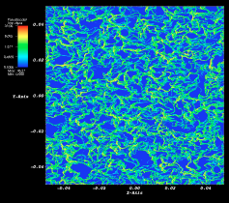
Non-linear evolution
Clumping of solids
with respect to the
local gas density
z
r
See also poster by Andreas Schreiber

Slide 18
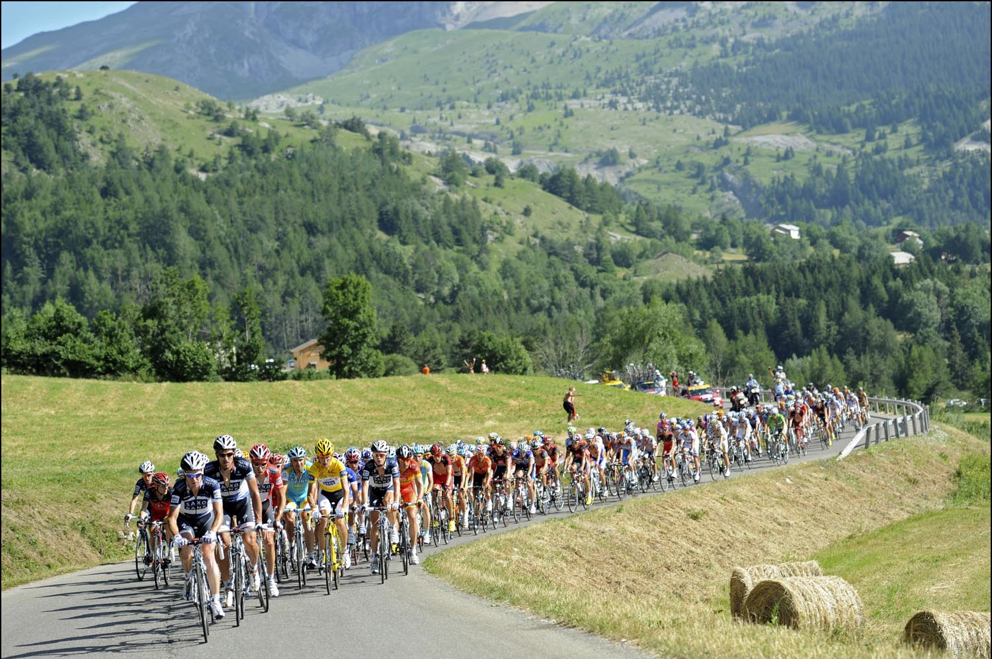
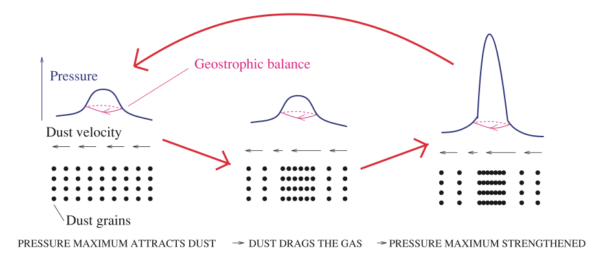
Interpretation
Various imperfect analogies:
  peloton (collective effect
  involving drag)
  dust feedback on gas
  to amplify pressure
  maximum
Jacquet
et al. ‘11

Slide 19
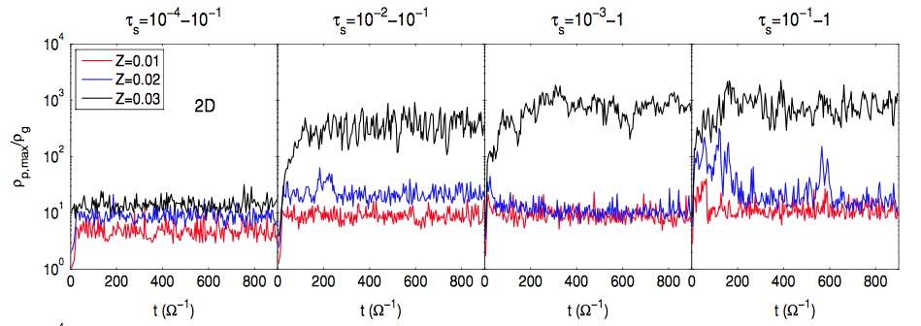
Maximum densities of solids attained
Bai & Stone ‘10
2D numerical simulations
  varying overall dust / gas ratio Z
  equal mass per logarithmic bin in τ
  models with different τ_{min}

Slide 20
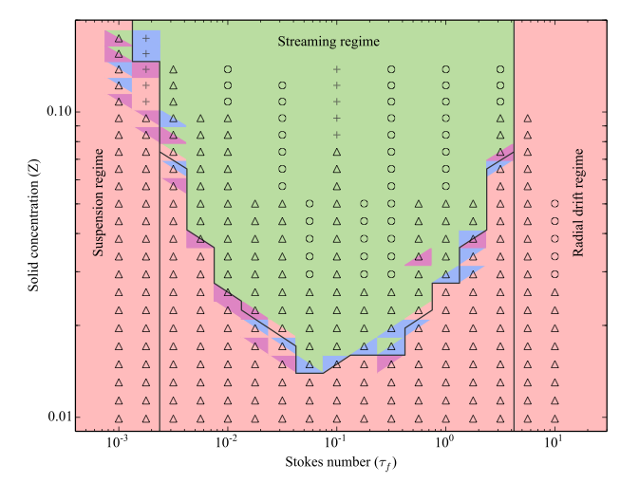
Carrera
et al. ‘15
stopping time
small τ, particles remain suspended
τ ~ 0.1 – strong clumping due to streaming
large bodies, radial drift wins
3 regimes:

Slide 21
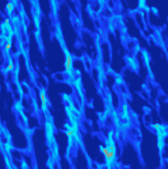
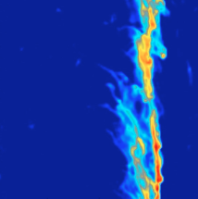
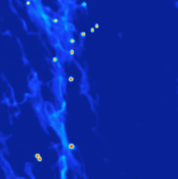
Streaming instability in (r,φ), turn on self-gravity
in saturated state of the instability
Simon et al., in prep

Slide 22
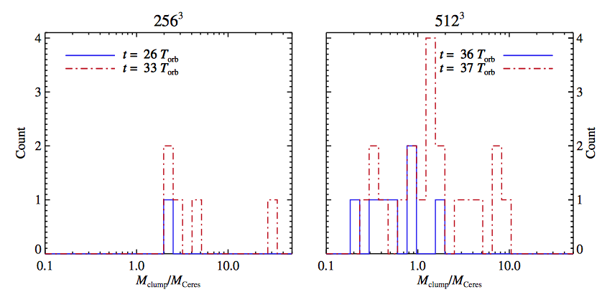
Size of streaming-induced clumps / planetesimals
Current simulations suggest very large bodies
are formed via this process (Johansen et al. 11)

Slide 23
How are pre-conditions for streaming instability (high
τ, moderately enhanced dust / gas ratio) attained?
Can this work:
  in inner disk, where τ ~ 0.1 is a large particle?
  across a broad range of radii?
Are numerical results on planetesimal size robust?
Is “pre-concentration” of solids in vortices, particle traps
necessary or important?

