Slide 1
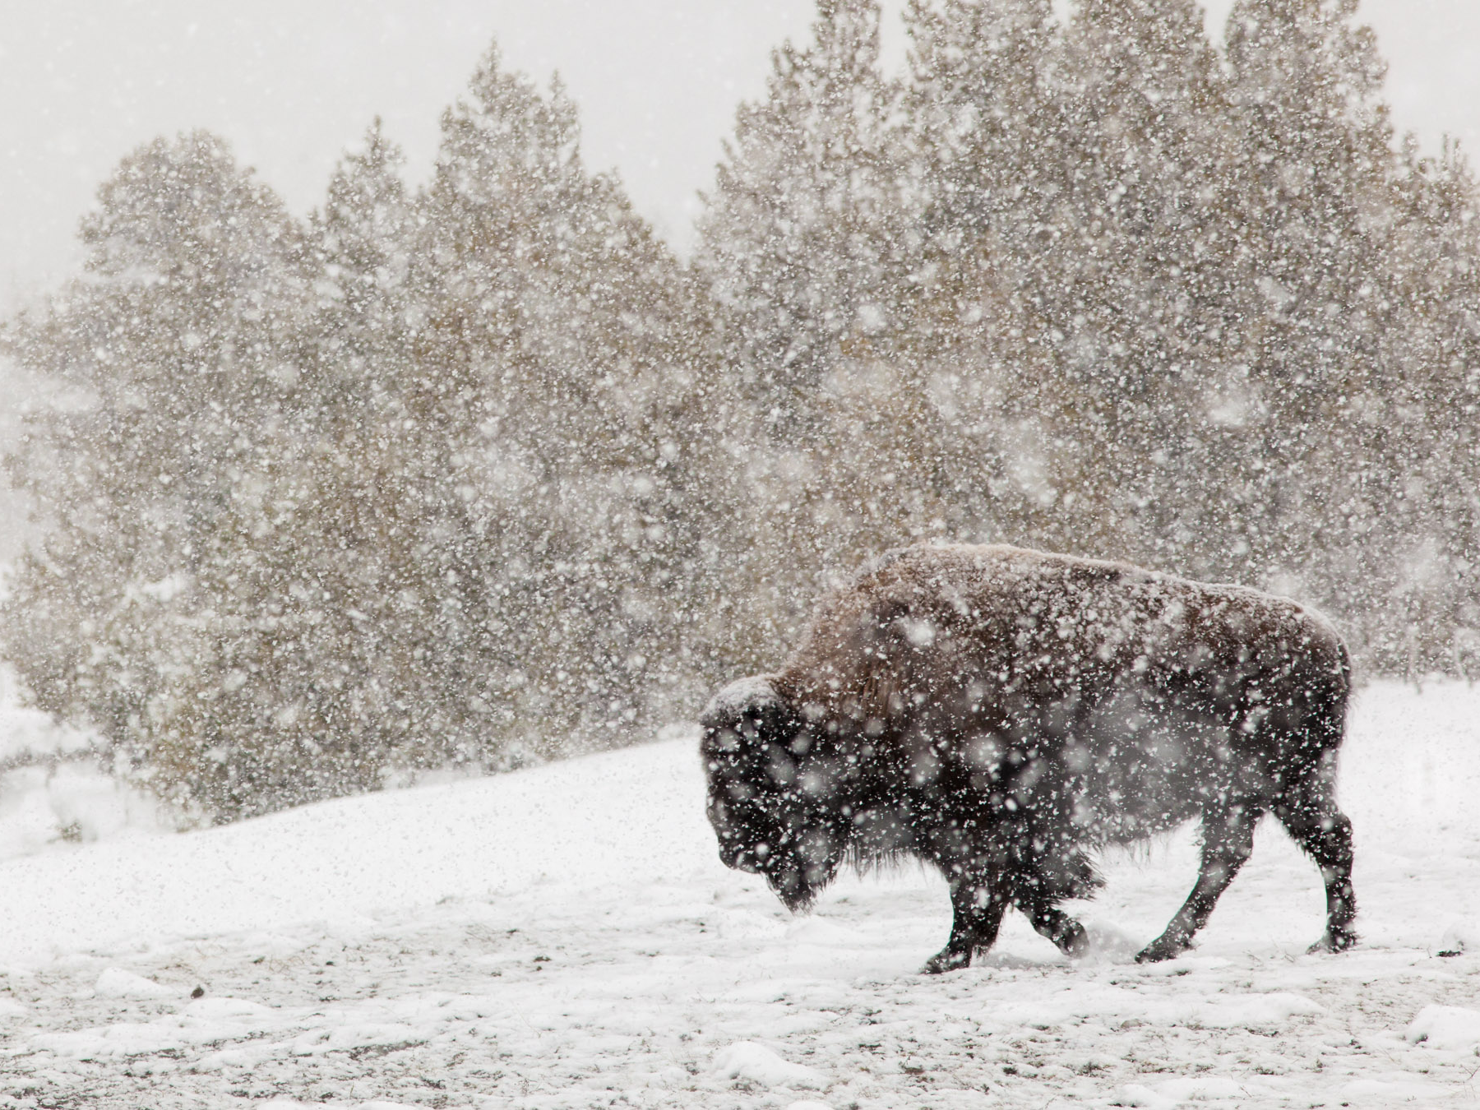
Processes in Protoplanetary Disks
Phil Armitage
Colorado

Slide 2
Processes in Protoplanetary Disks
Disk structure
Disk evolution
Turbulence
Episodic accretion
Single particle evolution
Ice lines and persistent radial structure
Transient structures in disks
Disk dispersal

Slide 3
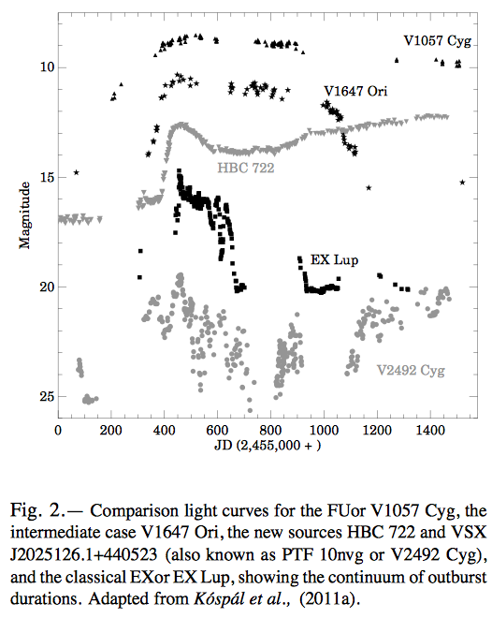
Episodic accretion
Range of (possibly)
related phenomena
FU Orionis events –
disk accretion outbursts
up to :
durations ~10-100 yr
Continuum of lesser
outbursts (“EXOrs”
etc), incompletely
characterized…
Audard et al. ’14, PP6

Slide 4
Episodic accretion
Range of observational / theoretical questions:
what is the origin of outbursts?
is most of the stellar mass accreted during outburst?
do outbursts continue throughout disk lifetime?
how do they impact planet formation?

Slide 5
Episodic accretion
Ideas for the origin of protostellar disk outbursts:
Recent review: Audard et al. PP6
accretion disk limit cycle
tidal disruption of clumps
binary-induced accretion

Slide 6
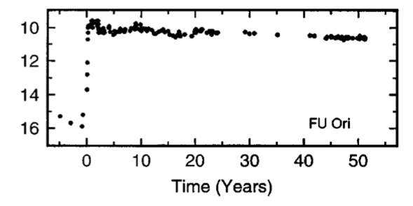
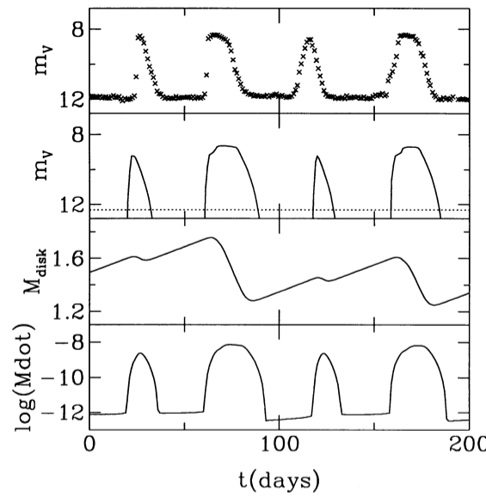
Accretion disk limit cycle
FU Orionis light curve
(Kenyon & Hartmann ’96)
Dwarf nova SS Cyg light curve
(Cannizzo ‘93)
Large amplitude outbursts are
observed in other accreting
systems, modeled as disk
limit cycles arising from
thermal instability

Slide 7
Classical disk instabilities
Disk evolution
equation
Diffusive, but solutions will be unstable if:
where ν is calculated for an annulus
of the disk at radius r in hydrostatic
and thermal equilibrium (Pringle ‘81)
Viscous instability – would lead to clumping into rings
In this simple treatment an unphysical solution, physically
a disk prone to viscous instability would be limited by
secondary instabilities before rings became too dense

Slide 8
Disk vertical thermal structure
If the disk is heated by accretion, need dT / dz < 0 to transport
energy from mid-plane to photosphere. Simple model:
T_{e}
z
F_{z}
T_{c}
If energy is dissipated at mid-plane, and
carried by radiative diffusion, vertical flux
is constant and linear in dT / dz
– Stefan-Boltzmann constant
κ_{R} – Rosseland mean opacity

Slide 9
Disk vertical thermal structure
integrate
…where τ = (1/2)κ_{R}Σ is optical depth to mid-plane
In thermal equilibrium, heating per unit area:
= cooling
But viscosity depends on T_{c}
Higher κ, τ
If opacity increases strongly
with T, get a runaway
Higher T_{c}
Stronger
heating

Slide 10
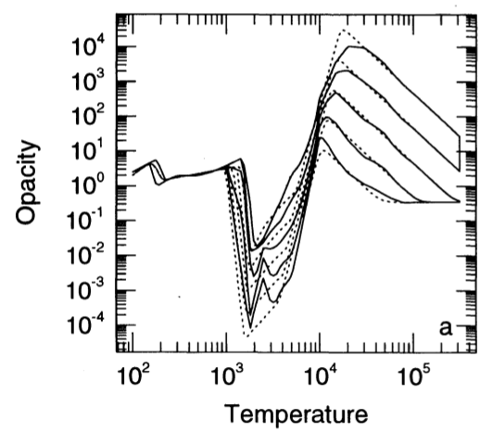
Thermal
instability
Formally
Physically, occurs due to sharp rise in opacity when
hydrogen is ionized
Bell & Lin ‘94

Slide 11
Thermal instability in disk at some r implies that mass
cannot be transported stably in some range of accretion rate
Can (but does not have to) allow a global limit cycle, in
which disk flips between:
high accretion rate, ionized, outburst state
low accretion rate, neutral, quiescent state

Slide 12
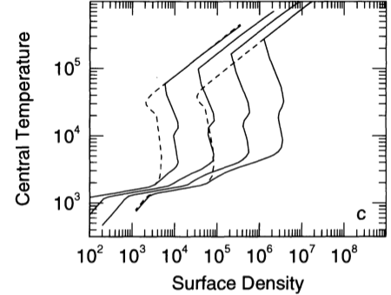
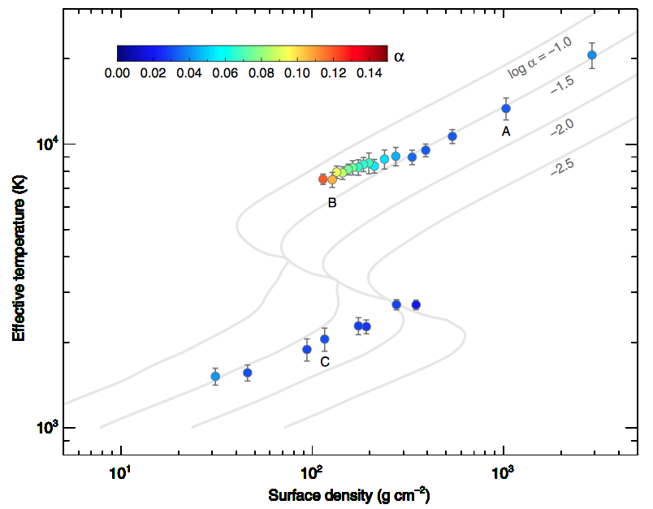
Thermal instability:
…is predicted for protoplanetary
disk vertical structures (Bell & Lin ‘94)
…for dwarf novae, present in
MHD simulations (Hirose et al. ‘14)
However… T_{c} ~ 10⁴ K only reached at very small r in
protoplanetary disks. A slow FU Orionis outburst lasting
100 years then requires α ~ 10⁻³ or 10⁻⁴
Inconsistent with MRI α, implies very massive disks

Slide 13
Same global behavior (outbursts) possible if the local
disk structure is bistable, for some other physical reason
try to accrete in unstable
strip of “S-curve” diagram
log (accretion rate)
local limit cycle
log Σ
Whether this gives rise to well-defined outbursts
depends on radial coupling between annuli,
various other fairly uncertain physics…

Slide 14
Gravo-magneto instability
upper branch is a thermally
ionized disk (T > 10³ K)
with active MRI and much
higher α, accretion rate
log (accretion rate)
transition is triggered when
disk becomes massive enough
for self-gravity to initiate
turbulence
log Σ
lower branch is Ohmic dead zone,
unable to transport gas flowing in
from outside, Σ grows over time
Armitage et al. ‘01, after Gammie ‘99

Slide 15
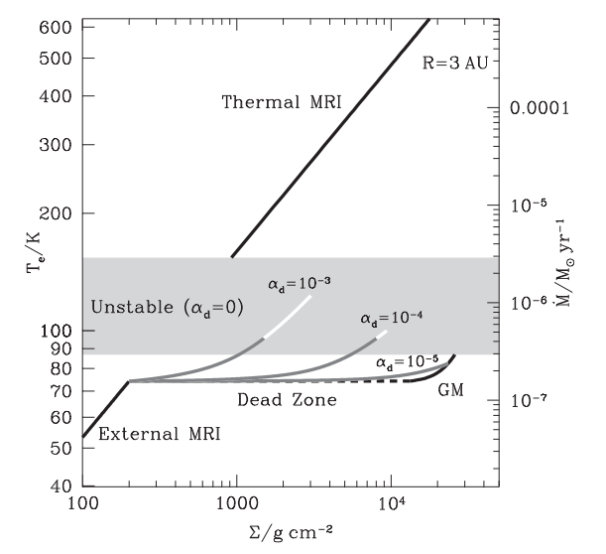
FUOr
accretion rate
T Tauri
accretion
rate
Vertical structure calculations by Martin & Lubow ‘14 assuming
efficient accretion in an ionized surface layer, and inefficient
but non-zero angular momentum transport in the dead zone

Slide 16
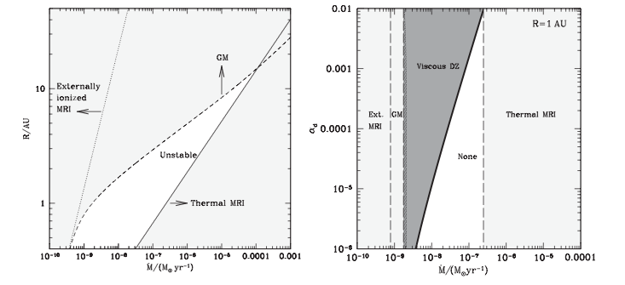
Martin & Lubow ‘14
With this dead zone model:
disk is unstable for broadly the “right” accretion rates
lower critical temperatures (compared to thermal
instability) allow for longer outbursts

Slide 17
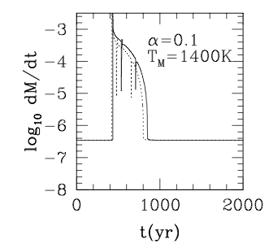
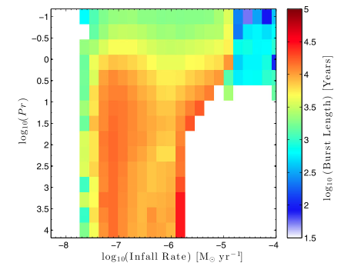
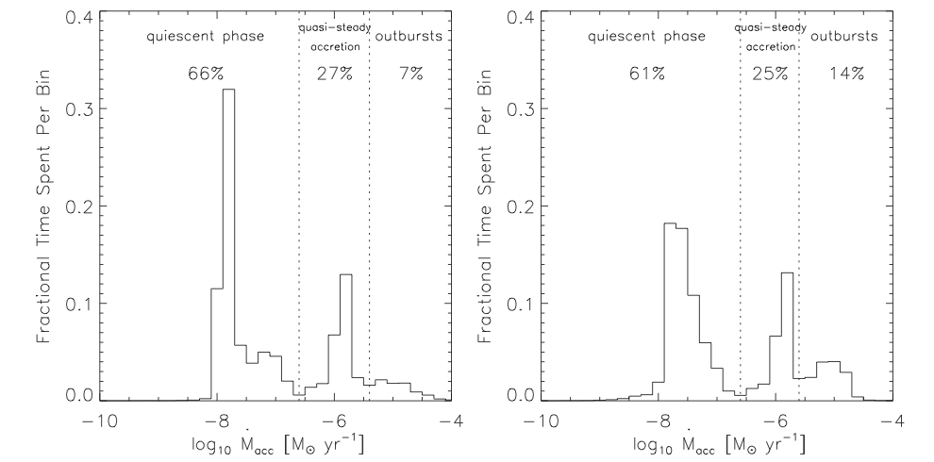
Zhu et al. ‘10
Owen & Armitage ‘14
Bae et al. ’14
2D disk
models with
explicit disk
self-gravity

Slide 18
Models suggest gravo-magneto instability could
occur for plausible mass inflow rates, properties
very roughly consistent with FU Orionis outbursts
Unclear if this is actually the right solution…
Hall effect, not Ohmic diffusion, is expected to
be dominant non-ideal process at relevant radii
Time scales of gravo-magneto bursts are
typically FUOr length, or longer… where
do lesser outbursts fit into this picture?

Slide 19
Clump tidal disruption
Alternate model: inner disk can be stochastically fed with
mass at rate >> viscous rate
outer disk (~10-100 AU) is gravitationally unstable
fragments into bound clumps with M ~ M_{J}
clumps migrate radially (Type I migration) faster
than they contract
tidally disrupted at small radii when:
outburst is Roche overflow accretion
Vorobyov & Basu ‘06; Boley et al. ‘10;
Nayakshin ‘11, Nayakshin & Lodato ‘12

Slide 20
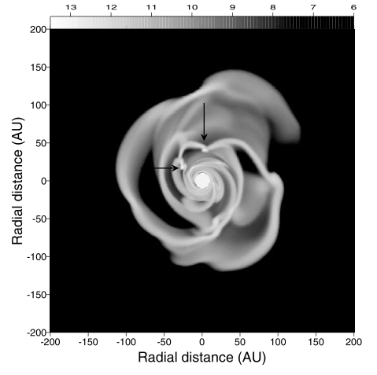
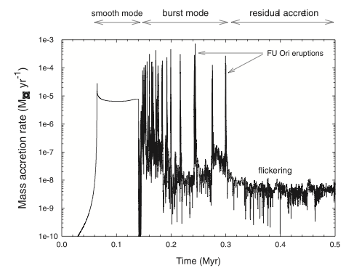
Vorobyov & Basu ‘06
Estimates: for h / r = 0.1, α = 0.1, viscous
time is 10 yr at r = 0.05 AU
Jupiter mass clump is tidally disrupted for ρ ~ 5 x 10⁻³ g cm⁻³,
corresponding to a radius of about 6 R_{J}

Slide 21
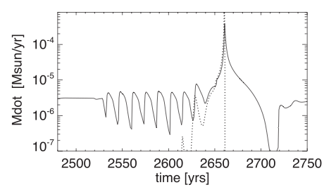
Nayakshin &
Lodato ‘12
Key questions:
Are FU Orionis objects all massive disks
Do clumps migrate fast enough so that they can
still be large enough to be tidally disrupted when
they reach the inner disk?

Slide 22
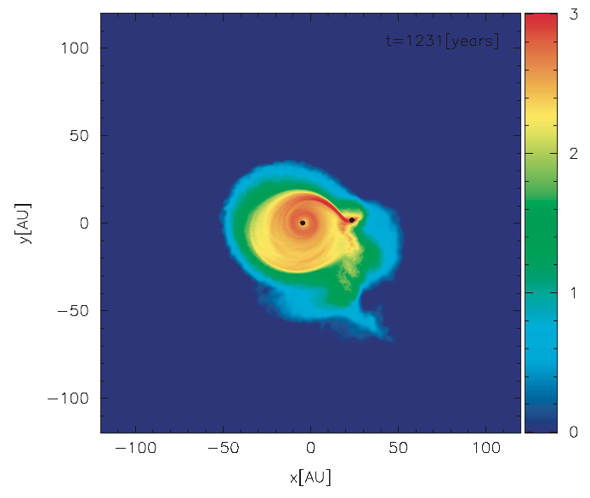
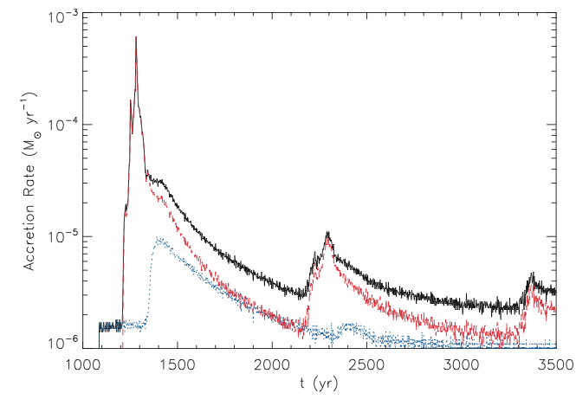
Close periastron passage of a binary will
trigger rapid accretion (Bonnell & Bastien ‘92)
Binaries
Forgan & Rice ‘10
Primary and secondary both experience enhanced mass
accretion – secondary ought to be observable

