Slide 1
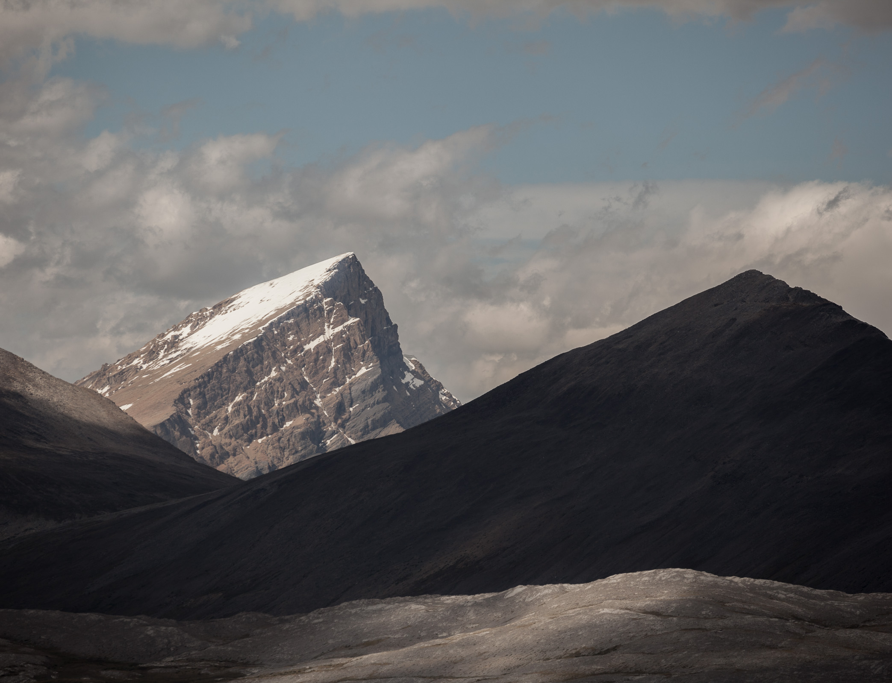
Processes in Protoplanetary Disks
Phil Armitage
Colorado

Slide 2
Processes in Protoplanetary Disks
Disk structure
Disk evolution
Turbulence
Episodic accretion
Single particle evolution
Ice lines and persistent radial structure
Transient structures in disks
Disk dispersal

Slide 3
Multiple
motivations
Turbulence
angular momentum transport
- disk evolution, episodic accretion, planet-disk
interactions
radial and vertical mixing / diffusion
- dust settling, chemistry, Stardust sample
interpretation…
concentration of particles
- observations of transition disks, prelude to
planetesimal formation, meteoritics

Slide 4
Multiple
sources
vortices?
purely hydro
magnetic
self-gravity
entropy
magnetorotational
instability (MRI)
gas
Toomre unstable
gas only
vs
gas + particles
linear vs
non-linear
vertical shear
instability (VSI)
baroclinic
instability
gas +
particles
particle feedback
on gas vs two-way
feedback
Kelvin-Helmholz
limit on settling
streaming instability

Slide 5
Turbulence
Fluid turbulence:
Define Reynolds number
Velocity U ~ km s⁻¹, L ~ AU, ν_{m} ~ 10⁶ cm² s⁻¹
Any turbulence present will be fully
developed – large inertial range
Re ~ 10¹²
BUT linear stability of shear flow is given by Rayleigh
criterion:
…for instability, l ~ r^{1/2} for Keplerian
flow so disks are linearly stable to
infinitesimal hydrodynamic perturbations

Slide 6
Linear instabilities
Consider a background disk model that is:
described by some set of physics (isothermal
hydrodynamics, MHD, hydro + self-gravity…)
in equilibrium
Linearize equations, perturb with e.g.
System is unstable if there are growing modes:
Main disk instabilities are also local, apply in a “patch”
of disk where shear is linearized, do not depend on
boundary conditions
Interested in existence, growth rate, non-linear outcome

Slide 7
1. Magnetorotational instability
Balbus & Hawley ‘91, review Rev. Mod. Phys. ‘98
Physics: hydrodynamics
magnetic fields
self-gravity
energy equation
✔
✔
✗
✗

Slide 8
1. Magnetorotational instability
B
y
z
r₀
x
Initial equilibrium state has a weak,
uniform vertical magnetic field B_{z},
assume ideal MHD
Unstable situation because magnetic field
acts like a spring that connects parcels
of gas with different angular velocity

Slide 9
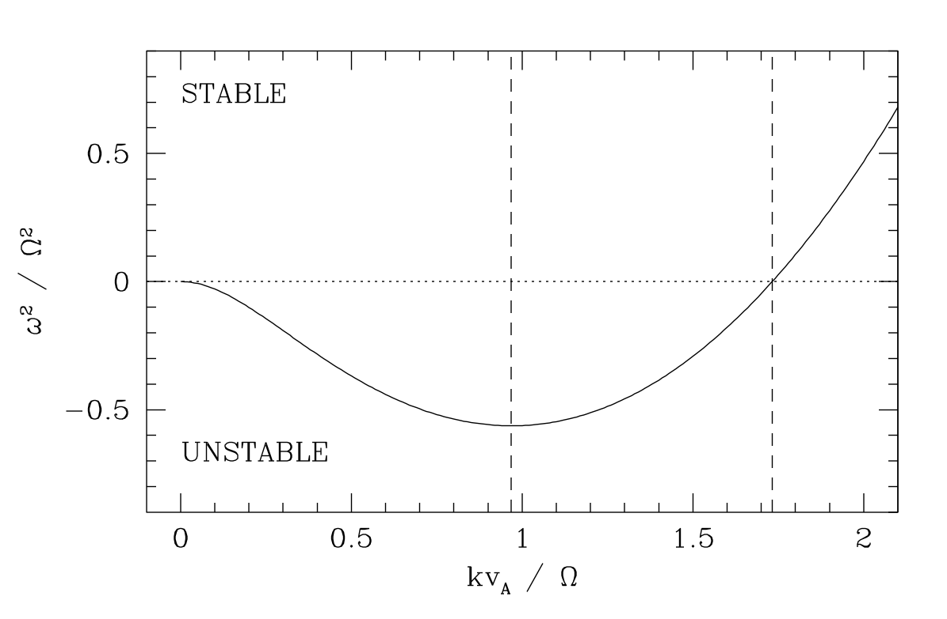
range of unstable wavelengths
unless B (and hence v_{A}) is too strong
most unstable wavelength with
growth rate ω ~ Ω i.e. very fast!
wavelength
For a weak
magnetic field,
unstable if
In ideal MHD,
always unstable

Slide 10
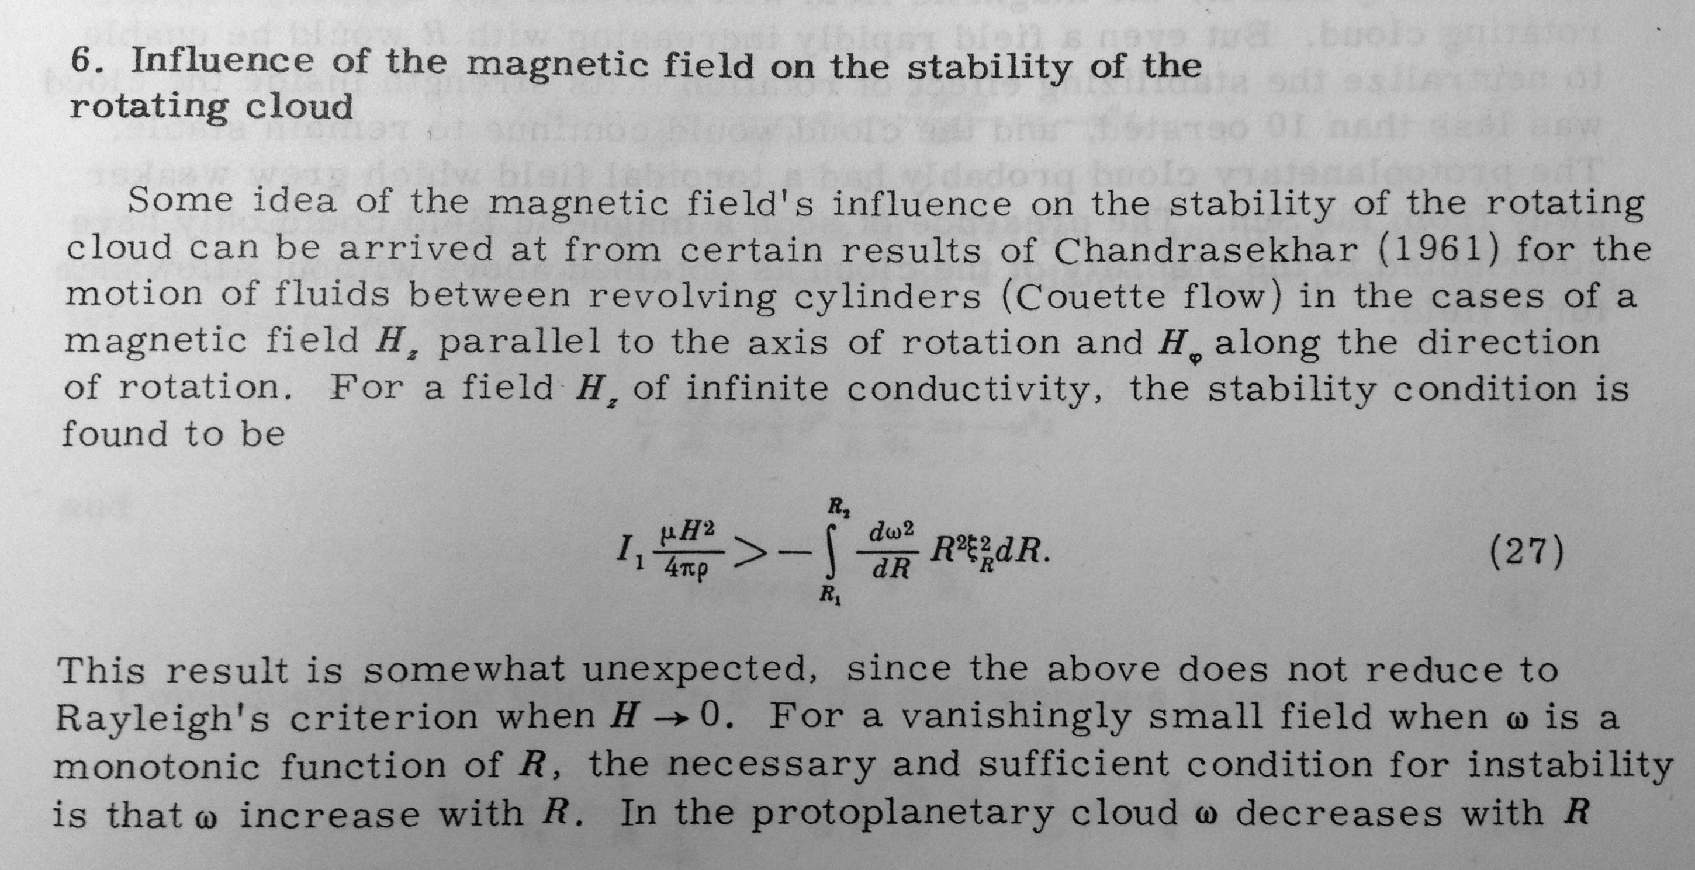
✔
✔
✗
✗
Safronov ‘72 – the MRI was almost discovered and understood
by Chandrasekhar, Velikov & Safronov in the 1960s…

Slide 11
Conclusion that weakly magnetized disks are always
violently unstable applies to ideal MHD (i.e. ionized disk),
several complexities in protoplanetary disks
currents decay due to collisions (Ohmic dissipation)
magnetic field couples to charged particles, neutrals
couple only via ion-neutral collisions (ambipolar
diffusion)
charge carriers moving in a magnetic field experience
a Lorentz force, creating an additional electric field
(Hall effect)
Very roughly, these “non-ideal” MHD effects damp the
MRI in regions where the ionization fraction and / or
density are very low

Slide 12
Ohmic Hall Ambipolar
Ideal MHD: MRI
grows on scale h
on time scale:
Diffusive term,
leads to damping
on time scale:
…with η the magnetic
diffusivity ~ 1 / conductivity
MRI damped for η > hv_{A}
For inner disk x_{e} > 10⁻¹²
Argument: Gammie ‘96

Slide 13
If MHD processes are dominant, expect suppressed
turbulence near the mid-plane – a “dead zone”

Slide 14
2. Self-gravity
Physics: hydrodynamics
magnetic fields
self-gravity
energy equation
✔
✗
✔
✗
Linear instability if “Toomre Q” is below critical value:
Roughly this requires M_{disk} / M* > h / r,
expect self-gravity to matter for massive disks

Slide 15
3. Vertical shear instability
Physics: hydrodynamics
magnetic fields
self-gravity
energy equation
✔
✗
✗
✔
and thermal diffusion due
radiation, heating + cooling
processes is “fast”
radial gradient
of specific
angular momentum
vertical gradient
of specific
angular momentum
Nelson, Gressel
& Umurhan ‘13

Slide 16
Non-linear evolution
With few exceptions, need numerical simulations to
assess:
non-linear evolution of disk instabilities
saturation level
nature of turbulence (waves, vortices…)

Slide 17
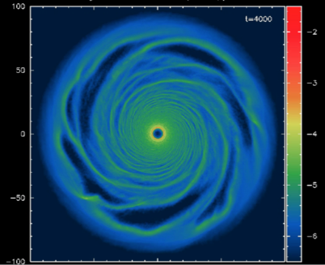
Self-gravitating disk simulation
(Richard Alexander)

Slide 18
Self-gravity: trailing spiral arms, “gravito-turbulence”
Assuming locality, condition that Q ~ Q_{crit} can be used
to analytically estimate the efficiency of angular momentum
transport (Gammie ‘01)
Heating rate (9/4)νΣΩ² must balance cooling σT⁴
where t_{cool} is the thermal energy
per unit area / cooling rate, and
γ is the adiabatic index of the gas
“Clumpiness” of the disk increases as t_{cool} decreases,
generally thought that fragmentation occurs for low t_{cool}Ω

Slide 19
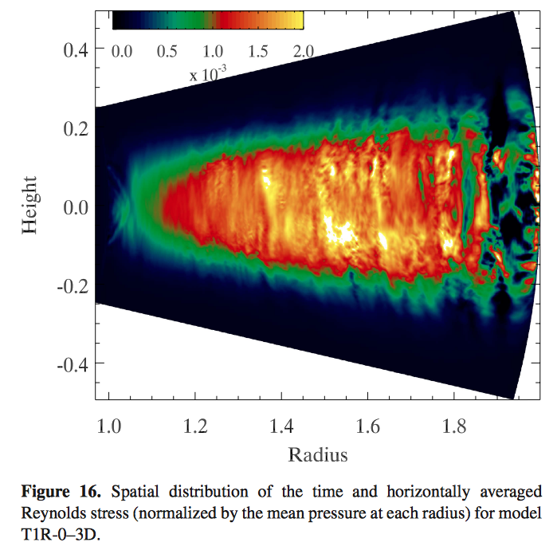
Vertical
shear
instability
Fluid stresses
with α ~ 10⁻³
Nelson
et al. ‘13

Slide 20
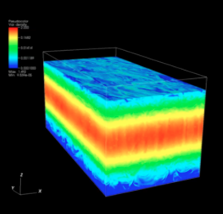
Magnetorotational
instability
In ideal MHD, leads
to turbulence with
~ 0.02, with most
of the stress coming
from magnetic rather
than fluid stresses
Relevant only to inner
protoplanetary disks
where T > 10³ K
Simon, Beckwith & Armitage ‘12

Slide 21

Magnetorotational instability
Relationship of magnetic field instabilities
to turbulence in the cool part of the disk
where non-thermal ionization dominates…
Secure results:
  Ohmic diffusion damps the MRI near the mid-plane
  in the terrestrial planet-forming region
  ambipolar diffusion damps mid-plane turbulence
  in the outer disk, strongly if there is no net B_{z}
Provocative results:
  MRI + net field leads to disk winds
  where Hall effect dominates, get a laminar magnetic
  stress whose strength depends on sign of B_{z}

Slide 22
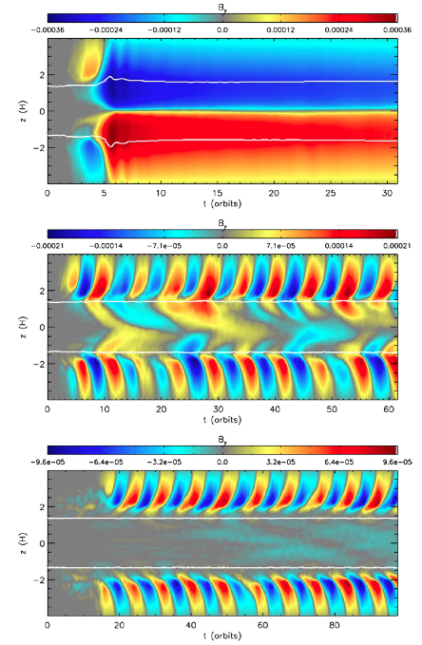
Simulations of the outer
disk have turbulent surface
layers, ambipolar damping
near the mid-plane
Stress and nature of the
solution strong function
of how much magnetic field
threads the disk (Simon
et al. 2013)

Slide 23
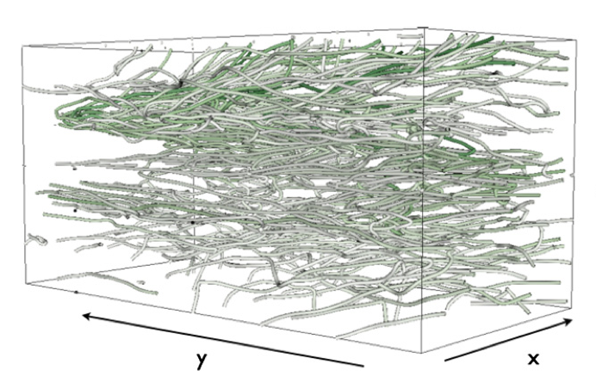
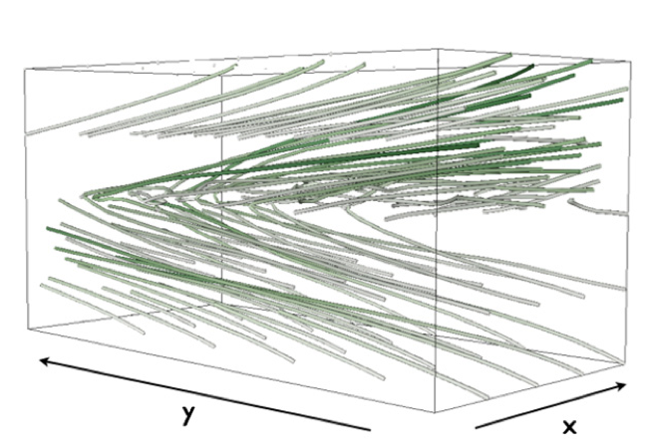
Vertical fields lead to a transition from turbulence to disk
winds, which may carry away significant mass and
angular momentum
β_{z} = 10⁴
β_{z} = 10³
Simon et al. 2013
Generic result (Suzuki & Inutsuka ’09; Fromang
et al. ‘13; Bai & Stone ‘13; Lesur et al. ‘13)

Slide 24
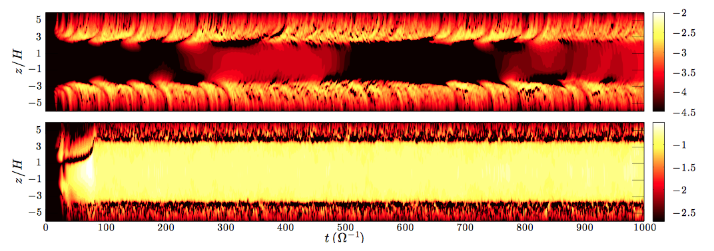
At r ~ AU, expect Hall effect to be dominant term
Ohmic diffusion only, get a dead zone with
very weak mid-plane stress / turbulence
with the Hall effect, strong laminar transport
of angular momentum due to Maxwell stress B_{r}B_{ο}
Lesur, Kunz & Fromang ‘14

Slide 25
Hall effect depends on the sign of (Ω.B)
Predict different levels of stress and turbulence in disks
where the net field is aligned / anti-aligned with rotation
Is disk structure
bimodal on
~AU scales?
Armitage, ARA&A ‘11

