Slide 1

Processes in Protoplanetary Disks
Phil Armitage
Colorado

Slide 2
Processes in Protoplanetary Disks
Disk structure
Disk evolution
Turbulence
Episodic accretion
Single particle evolution
Ice lines and persistent radial structure
Transient structures in disks
Disk dispersal

Slide 3
The central problem
The gas orbital velocity
is accurately Keplerian
Specific angular momentum
is robustly an increasing
function of radius
Even though lowest energy state favors
gas accreting on to the star, angular
momentum conservation forbids it

Slide 4
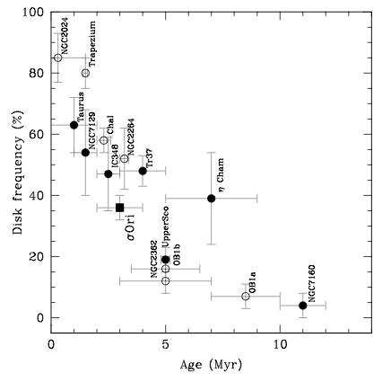
The central problem
Consistent with long observed
disk lifetimes – disks are
quasi-equilibrium structures
that evolve slowly compared
to dynamical time scale
Hernandez et al. ‘07

Slide 5
The central problem
(2)
Redistribution of
angular momentum
within disk
Loss of
angular
momentum
in a wind
(1)
“Viscous” disk: angular
momentum mixed by
internal turbulence
if field line is
like a rigid wire
Not mutually exclusive!

Slide 6
Classical disks
Lynden-Bell & Pringle ’74; Shakura & Sunyaev ’73 theory:
disk is geometrically thin (h/r << 1), axisymmetric, planar
angular momentum redistribution is modeled as a
Navier-Stokes shear viscosity (kinematic viscosity ν)
continuity +
angular
momentum
conservation
specification of the torque G –
local, scales linearly with shear

Slide 7
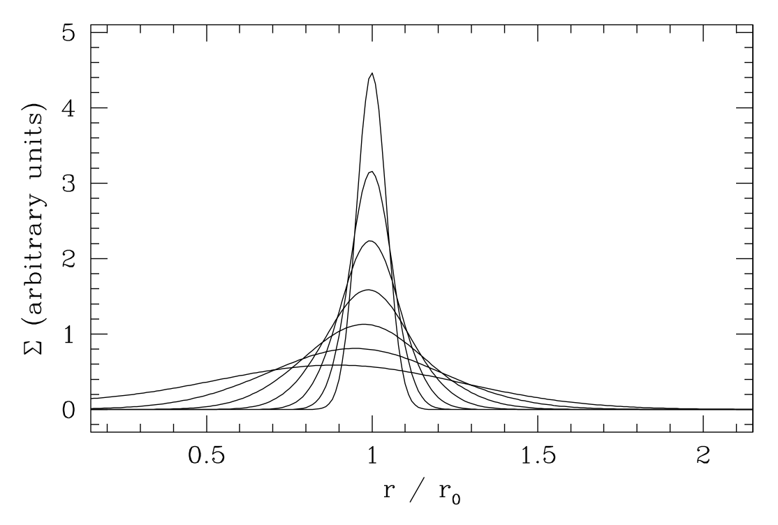
Keplerian potential
specializes to…
Diffusive evolution of surface density Σ
Viscous time scale:
Green’s function solution:
mass flows to r = 0, while
angular momentum
carried by tail of mass
to infinity

Slide 8
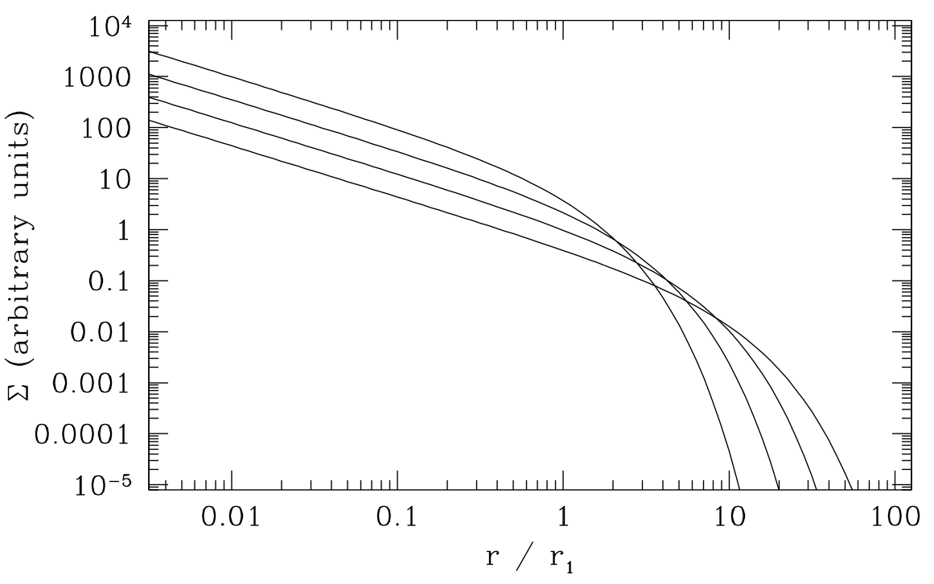
In steady-state, if:
Also have explicit self-similar solution:
Simple model to
fit to observations

Slide 9
How applicable is classical disk theory?
Angular momentum transport is not due to real “viscosity”
~km s⁻¹
~10 cm
However, obtain same one-dimensional evolution equation
if transport is due to an average turbulent stress, provided
it is locally defined. e.g. for a fluid with magnetic fields,
transport from fluid (“Reynolds”)
and magnetic (“Maxwell”) stress
Balbus & Papaloizou ‘99

Slide 10
How applicable is classical disk theory?
Things will go wrong if we try to apply the theory when:
transport mechanism is non-local (e.g. self-gravity
when M_{disk} is not much smaller than M*)
mass loss (e.g. from photoevaporation) occurs on
a time scale < viscous time scale
1D situations where Ω far from Keplerian
time scales shorter than correlation time for turbulence
any 2D or 3D situation (warps, eccentric disks,
meridional circulation)…

Slide 11
α-model disks
Can make a predictive theory if we can write ν as a function
of other disk parameters (T, r, ρ, x_{e}…)
Shakura-Sunyaev ‘73 α-prescription
For α assumed constant, one parameter description of
protoplanetary disk evolution
Identify disk lifetime with the viscous time at outer edge
t_{ν} = 1 Myr at 30 AU, (h / r) = 0.05
α = 0.01

Slide 12
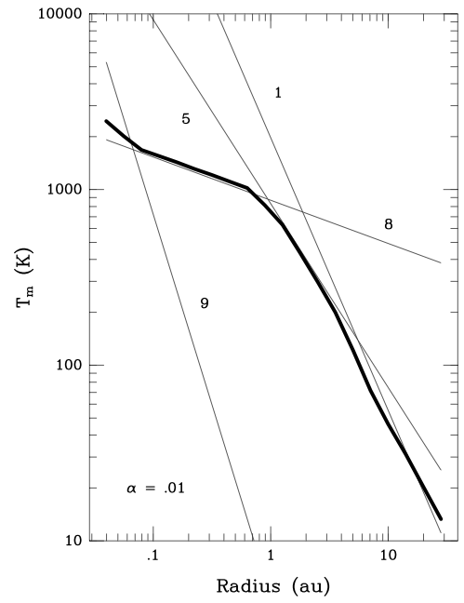
If irradiation dominates,
with fixed T ~ r ^{-1/2}, then
an α-disk is equivalent to
~ r (since ν = αc_{s}² / Ω)
An α model predicts the
time-varying radial (and
vertical) structure for
any accretion rate
e.g. snow line near 4 AU
for this model
accretion rate 10⁻⁷ M_{Sun} yr⁻¹
Bell et al. ‘97

Slide 13
We can always choose to express the
efficiency of angular momentum transport
in terms of α
α-disk theory is useful if it encodes the “leading order”
dependence of the stress on the local disk properties,
i.e. so that α is a slowly varying function of Σ, r etc
Various caveats:
α likely a strong function of T, Σ, if transport is due
to MHD processes
vertical structure also depends on how accretion
energy is distributed vertically… even more uncertain
for comparison against observations, reducing a
possibly complex function to one number

Slide 14
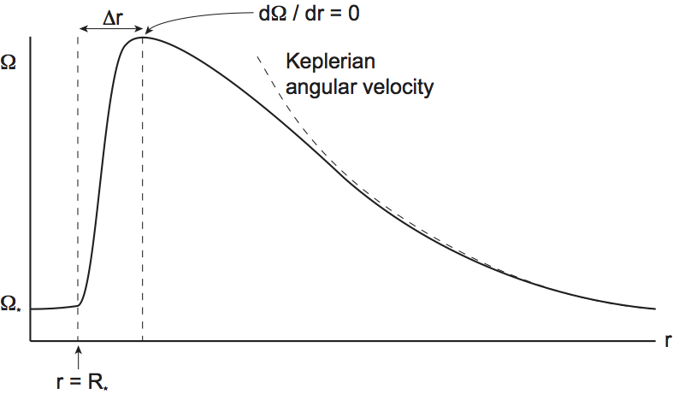
Star-disk interactions
For a weakly-magnetized star: boundary layer
Classical theory:
point in flow at
where dΩ/dr = 0
viscous stress vanishes
disk has a boundary
condition of zero torque
star accretes gas with high angular momentum
kinetic energy of disk is dissipated in narrow
boundary layer, expected to be hot and luminous

Slide 15
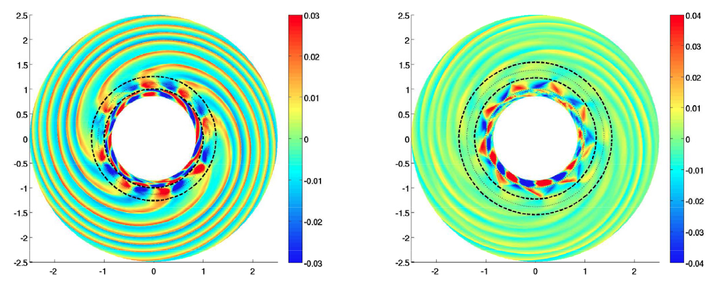
Belyaev et al. ‘13
Boundary layer models are sensitive to the nature of disk
angular momentum transport: dΩ / dr has opposite sign
Boundary layer flow is not unstable to the magnetorotational
instability, rather evidence for transport by acoustic waves
(non-local, not a “viscosity” at all!)

Slide 16
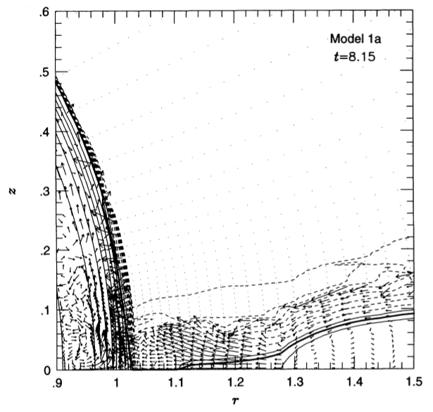
In protostellar accretion, boundary layers occur at high
accretion rate (FU Orionis objects)
Radiation hydrodynamics likely
important in determining the
structure of the boundary layer
Kley & Lin ‘96
Where is accretion energy released in FU Ori boundary
layers if waves transport angular momentum?
What is structure of circumplanetary disk boundary layers?

Slide 17
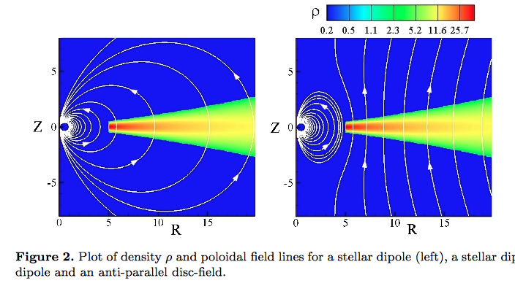
At low accretion rates,
expect magnetospheric
accretion
Simulation: Dyda et al. ‘15
Suppose vertical field
at disk surface is a dipole,
toroidal component similar
Then magnetic torque on surface of disk
Time scale for stellar torque to
drive inflow is shorter than
viscous time inside some
magnetospheric radius r_{m}

Slide 18
Very rough, but weak function
due to rapid dipole fall off
For kG fields, 10⁻⁸ M_{Sun} yr⁻¹, typically r_{m} = 10-20 R_{Sun}
Consequences:
gas accretes along magnetic field lines (free-fall,
accretion shock on surface)
magnetic field allows star to exert a non-zero
torque on disk inner edge (in principle, star may
spin down)
innermost disk is missing

Slide 19
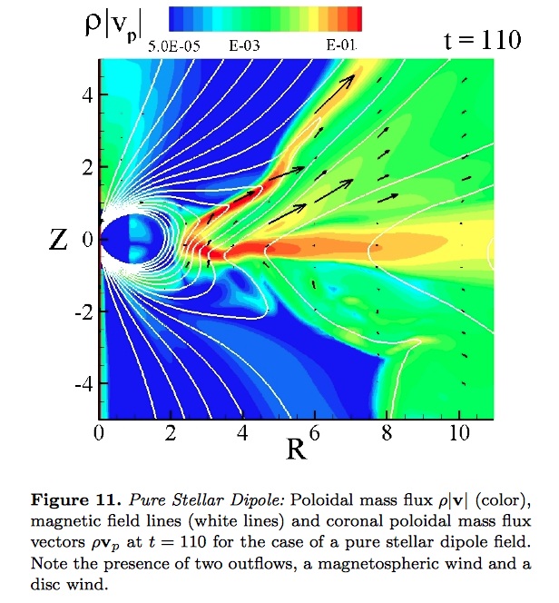
Interaction between
disk and stellar
field close to r_{m}
favorable location
for launching
jets
Dyda et al.’15

Slide 20
Another non-zero torque case
for circumbinary disks
Assume gravitational torques from
binary completely forbid inflow
through some inner radius r = r_{in}
In 1D:
Analytic Green’s function solution describing decretion disk
disk L increases due to binary torque
both the mass and angular momentum eventually
flow outward
energy / angular momentum comes from binary,
which shrinks

Slide 21
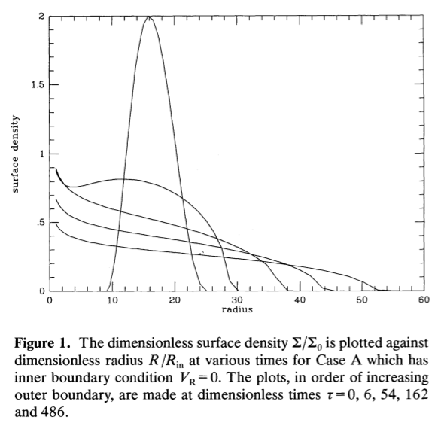
Analytic solution
Pringle ’91
Prototype for “Type
II” planetary migration

Slide 22
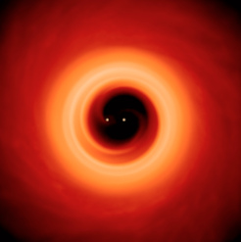
Even in binaries, gas can
flow across barrier and
be accreted / form smaller
disk around individual
stars
Artymowicz & Lubow ‘96
Critical physics for
massive planet growth
and migration
Simulation Cuadra et al. ‘09
How does this operate with realistic disk turbulence?

