Slide 1
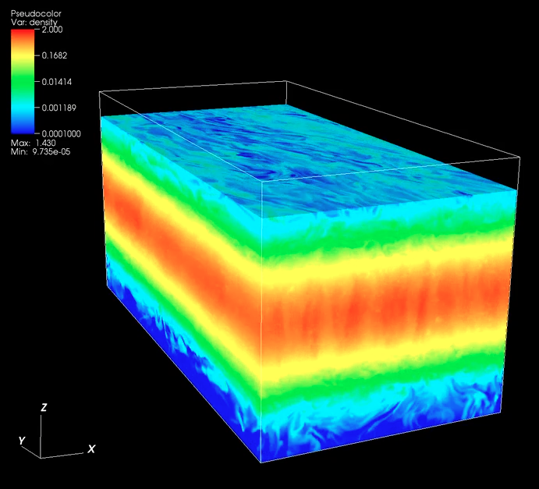
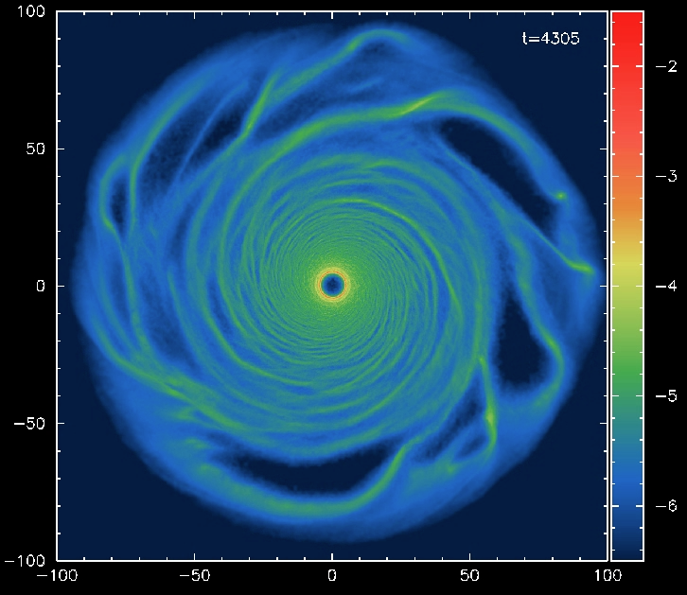
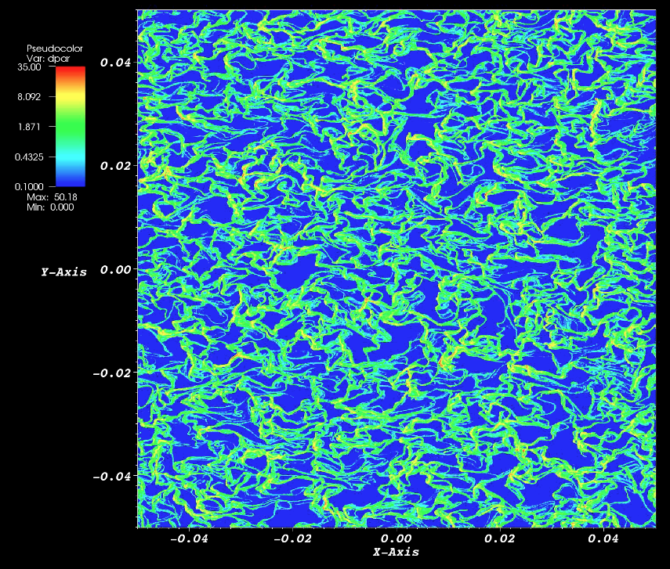
Processes in Protoplanetary Disks
Phil Armitage
Colorado

Slide 2
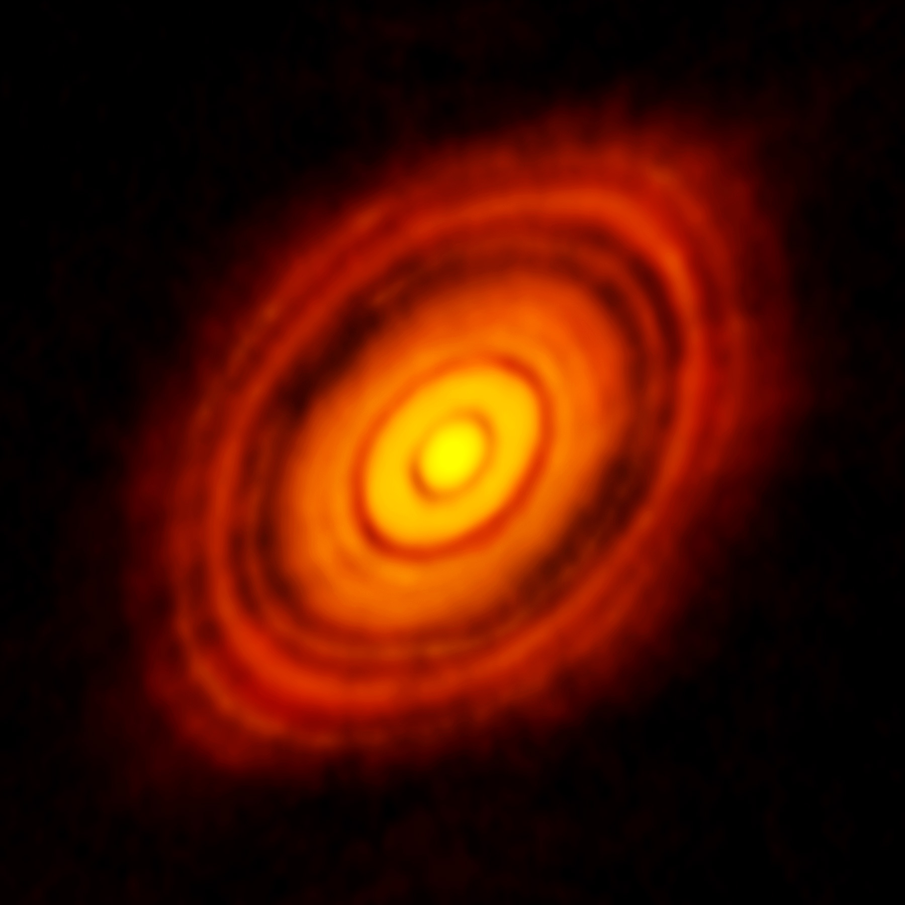
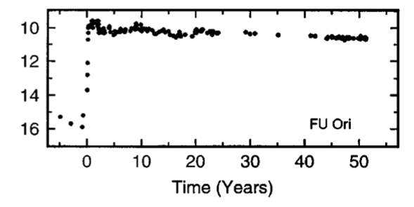
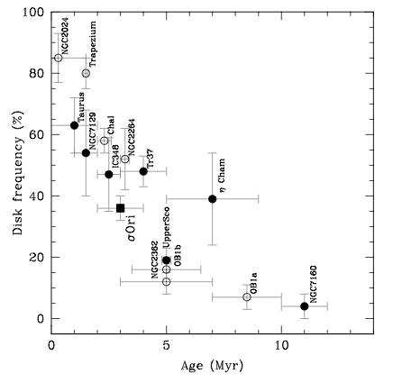
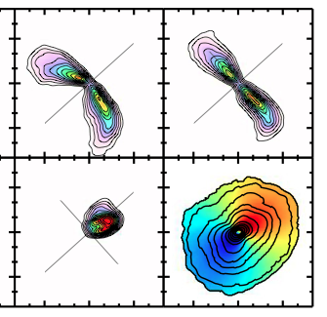
What can we directly observe?
Motivation
Dust
μm-mm
Limited
direct
time
dependence
Hartmann & Kenyon ‘96
HL Tau, ALMA
Evolution
from
population
studies
Gas –
emission &
kinematics
(CO + other
molecules,
H₂ hard)
Rosenfeld et al. ‘13
Hernandez et al. ‘07

Slide 3
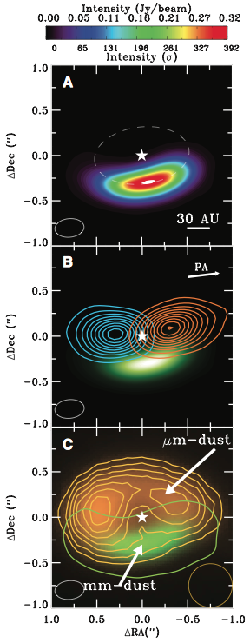
Motivation
What do we aim to learn?
Why and how disk evolve
Physical conditions for planet
formation (density, temperature,
level of turbulence…)
Interaction and growth of solids
within the gas
Origin of structure within disks
Planet-disk interactions
Goal: introduce disk physics that links
observations to planet formation
IRS 48, van der Marel et al. ‘13

Slide 4
Processes in Protoplanetary Disks
Disk structure
Disk evolution
Turbulence
Episodic accretion
Single particle evolution
Ice lines and persistent radial structure
Transient structures in disks
Disk dispersal

Slide 5
Disk structure
Basic principles: disks are long-lived and (usually) well
approximated by -
hydrostatic equilibrium
thermal equilibrium
local ionization equilibrium
In many cases chemistry is not necessarily in equilibrium

Slide 6
Consider a disk:
  heated from star (~vertically isothermal)
  gas pressure dominated
  of low mass compared to star
Disk structure
dP/dz
z
d
F_{grav}
θ
r
In hydrostatic equilibrium:
Write P = ρc_{s}², for z << r:

Slide 7
Define disk scale height
Vertical density profile is gaussian
Disk surface density
Order of magnitude: at 1 AU, Σ ~ 10³ g cm⁻², h / r ~ 0.03
ρ₀ = 10⁻⁹ g cm⁻³
c_{s} = 10⁵ cm s⁻¹ (1 km s⁻¹)
mean free
path λ ~ cm

Slide 8
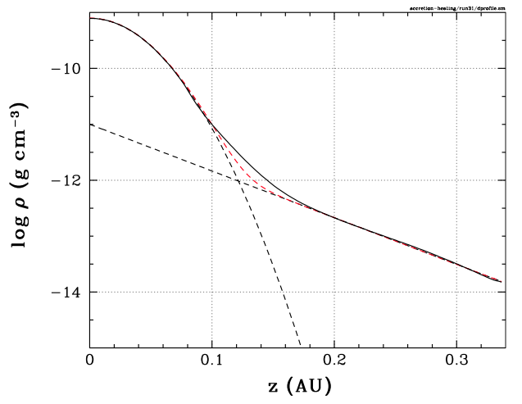
What could alter vertical density profile?
self-gravity, condition is roughly
magnetic pressure B² / 8π
Hirose & Turner ‘11 find
magnetic support above
about z ~ 4h, leading to
an exponential atmosphere
(1 AU, flux-limited diffusion)
z ~ 4h
Depends on MHD processes
in disk, in some cases B(z)
may have larger effect

Slide 9
Velocity structure
gravity
rotation
pressure gradient
For a slowly evolving disk, in axisymmetry:
P = ρc_{s}², and c_{s} ~ h, so 2nd term O(h/r)²

Slide 10
A specific example: Σ ~ r⁻¹, T_{c} ~ r^{-1/2}
At 1 AU, if (h/r) = 0.03:
  gas is sub-Keplerian by ~0.25%
  |v_{φ} – v_{K}| ~ 70 ms⁻¹
Non-self-gravitating disks can be treated as Keplerian
for all practical (gas dynamical) purposes
Small deviation has outsized importance for particle
dynamics!

Slide 11
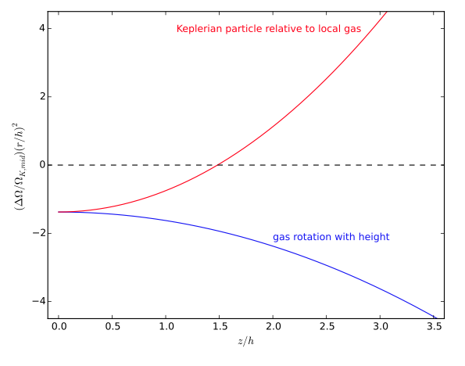
At same order
(h/r)² there is
vertical shear
in the equilibrium
velocity field, even
if disk is vertically
isothermal
see Takeuchi & Lin ’02 for calculation
Rosenfeld et al. ’13 – effects at this order are potentially
observable in molecular line kinematics

Slide 12
Temperature
Stellar irradiation vs heating by accretion
Globally, accretion dominates if:
Both heating sources can matter – depends on accretion
rate, stellar mass, radius…

Slide 13
starlight heats dust
optically thin dust emits IR
optically thick dust emits
longer λ IR
dust & gas exchange
energy
gas cools
line emission
from gas
warm dust
emission
optically thick
disk emission
stellar photons λ ~ 1 μm
dust
gas-dust
collisions
photo-electric
heating (UV)

Slide 14
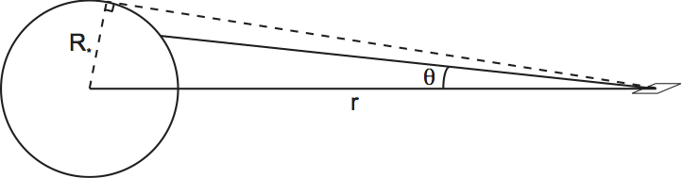
Simple limit: razor-thin, optically thick disk, intercepts star light
and re-emits locally as blackbody emission
Evaluates
exactly to:
Asymptotically (r >> R*)
…disks usually flare
to large distances

Slide 15
Additional physics for dust emission
Disk flares, intercepts more flux at large r than flat disk
(Kenyon & Hartmann 1987)
2) Surface dust radiates inefficiently (size smaller than the
wavelength of re-emitted IR radiation)
thermal equilibrium
for dust, radius s
absorption
re-radiation
emissivity, with β ~ 1
warm optically thin emission
from surface dust layer

Slide 16
Approximate analytic models:
50% of disk L in blackbody
interior emission
50% in emission from a
warmer surface dust layer
Chiang & Goldreich ’97 – Σ = 10³ (r / AU)^{-3/2} g cm⁻², M = 0.5 M_{Sun},
T = 4000 K, R* = 2.5 R_{Sun}
Garaud & Lin ‘07 for version including accretion heating
Passive disks have T ~ r ^{-0.5}, flare to large r, any
contribution from accretion heating greater at small r

Slide 17
What about the gas temperature?
Heating
collisions between molecules and dust particles
- efficient equilibration at high density: T_{gas} = T_{dust}
photoelectric heating near surface
UV photon,
E = 10 eV
90% of time: energy thermalized in grain
10% of time: eject an electron into gas
electron: E_{e} = E_{UV} – w ~ 5 eV
~5% of incident UV flux goes into gas heating
Cooling – rotational transitions (e.g. CO), atomic fine
structure lines

Slide 18
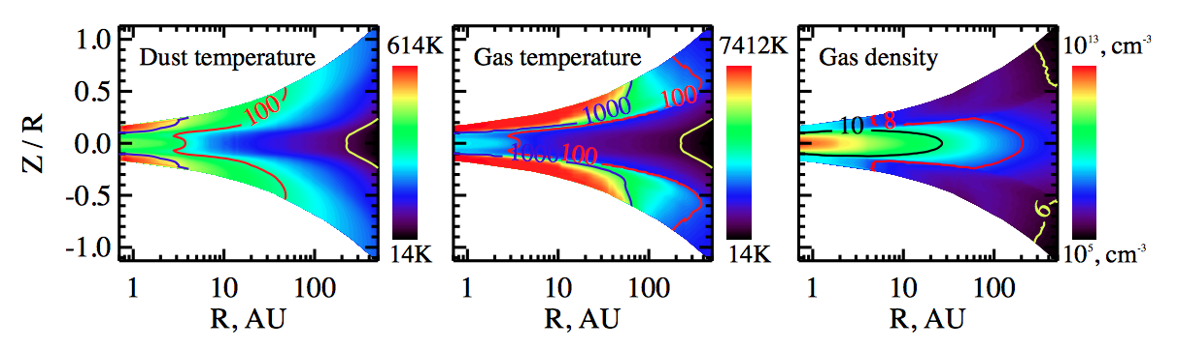
Henning & Semenov ‘13, from Akimkin et al. ‘13
General structure:
  optically thick, vertically isothermal structure near
  disk mid-plane
  warmer dust at surface
  still warmer molecular layer of gas
Need numerical codes to compute gas + dust models

Slide 19
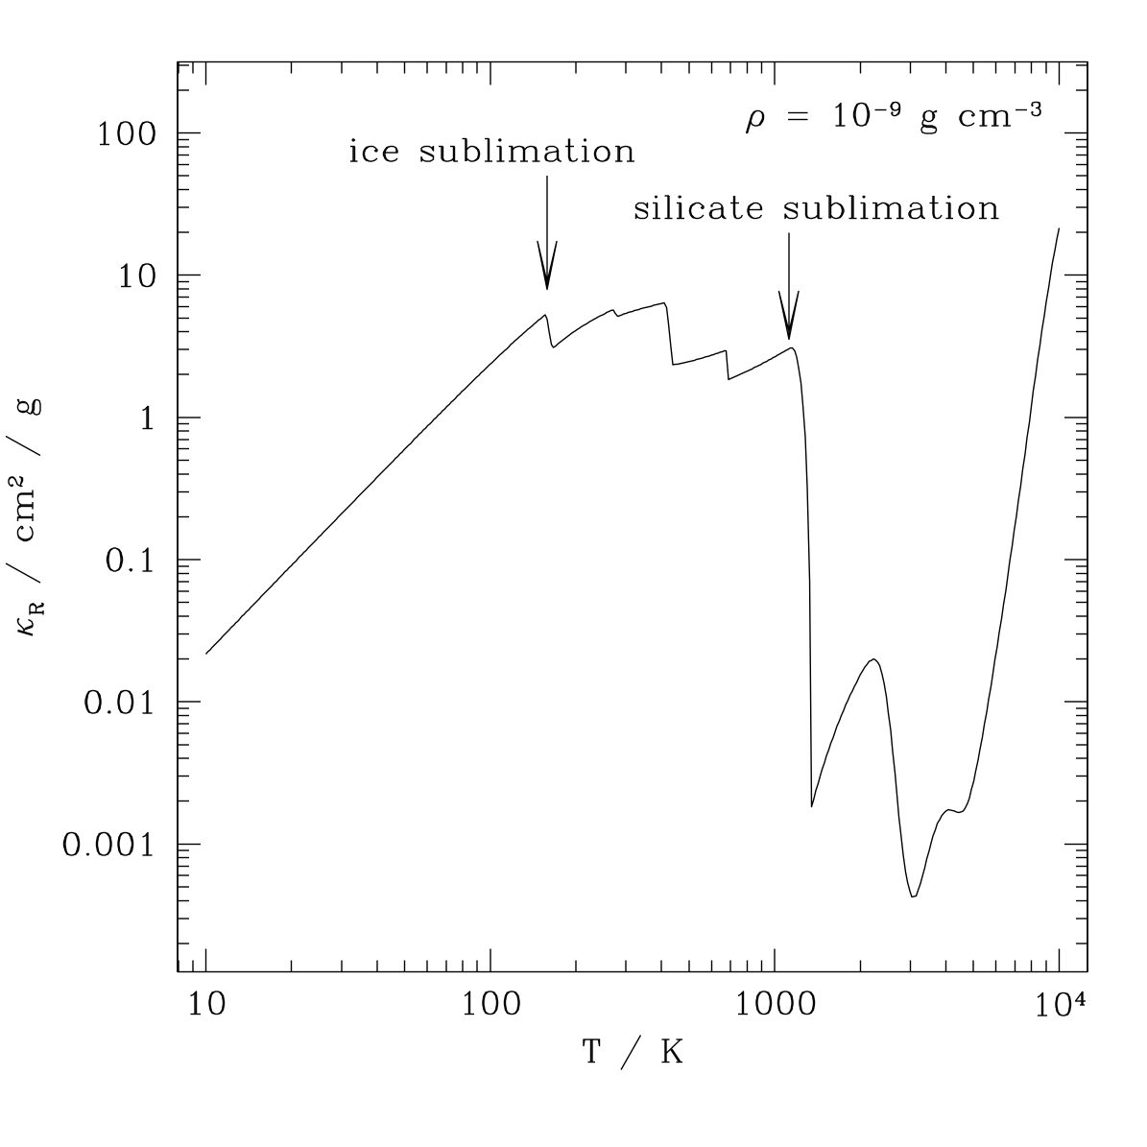
Ionization fraction x_{e} = n_{e} / n_{H} affects:
  chemistry
  coupling of gas to magnetic fields
Ionization
Thermal ionization
Gas becomes fully ionized
only at T ~ 10⁴ K
These temperatures attained
only in very high accretion
rate states
Change in opacity when H
is ionized is important for
episodic accretion models
ionization of hydrogen
(opacity from Semenov et al. ‘03)

Slide 20
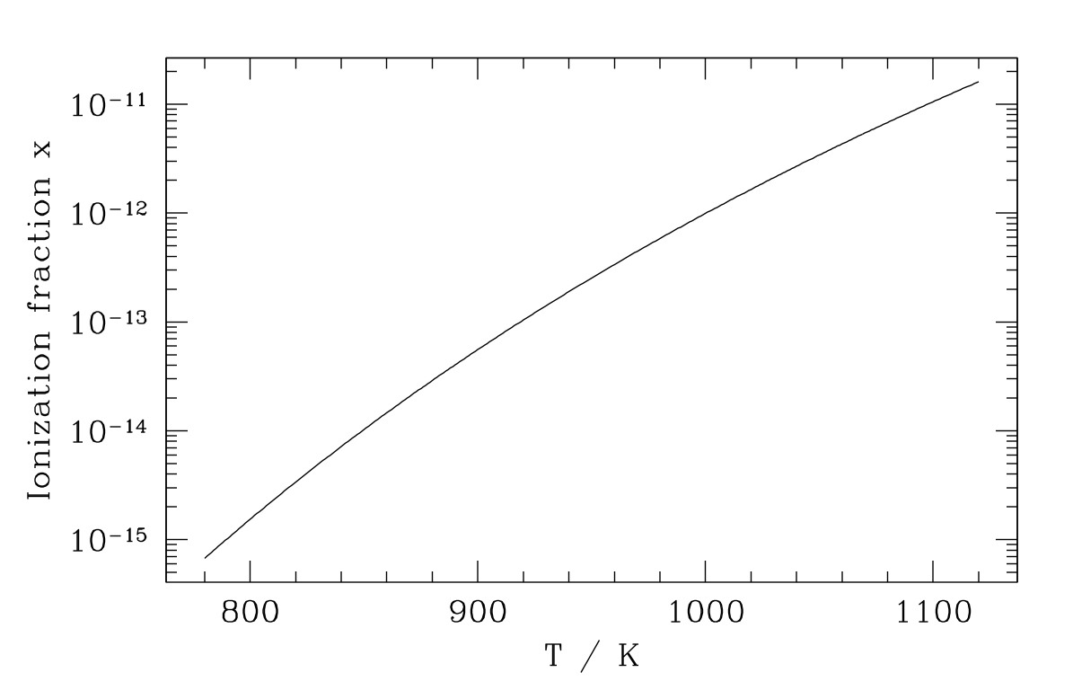
Thermal ionization
Ionization of the alkali
metals occurs at
T ~ 10³ K
Yields an electron
fraction x_{e} ~ 10⁻¹²
Very low ionization degree, but comparable to the
ionization needed to couple magnetic fields to gas
Calculation: use Saha equation,
answer just f(T,ρ)

Slide 21
Non-thermal ionization – this is much nastier!
Need to know and balance:
  explicit ionization rates ζ from non-thermal processes
  specific reactions that lead to recombination
e.g. if dominant reaction is recombination with molecular
ions (“dissociative recombination”), such as
e⁻ + HCO⁺ H + CO
rate
equation
in ionization
equilibrium
neutrals
rate coefficient (function of T)
Solution assuming
overall neutrality

Slide 22

far-UV photons, ionize
C, S etc to depth of 0.01
to 0.1 g cm⁻² column
Non-thermal ionization
stellar X-rays (5 keV),
stopping depth 5-10 g cm⁻²
unshielded cosmic
rays, stopping depth
~100 g cm⁻²
radioactive
decay
²⁶Al normally
dominant

Slide 23
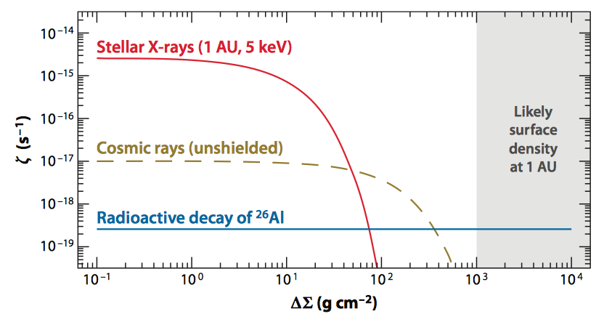
Simplified model
for ionization rates
after Turner &
Sano ‘08
Mid-plane of the inner disk is too cold to be thermally
ionized, dense enough to be shielded from external
sources of ionizing radiation… very low x_{e}

Slide 24
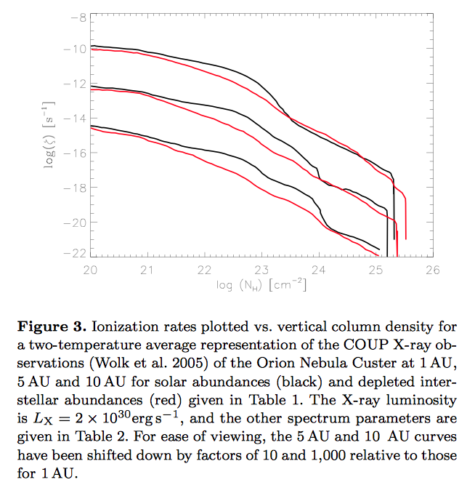
Stellar X-ray
ionization from
Ercolano &
Glassgold ‘13

Slide 25
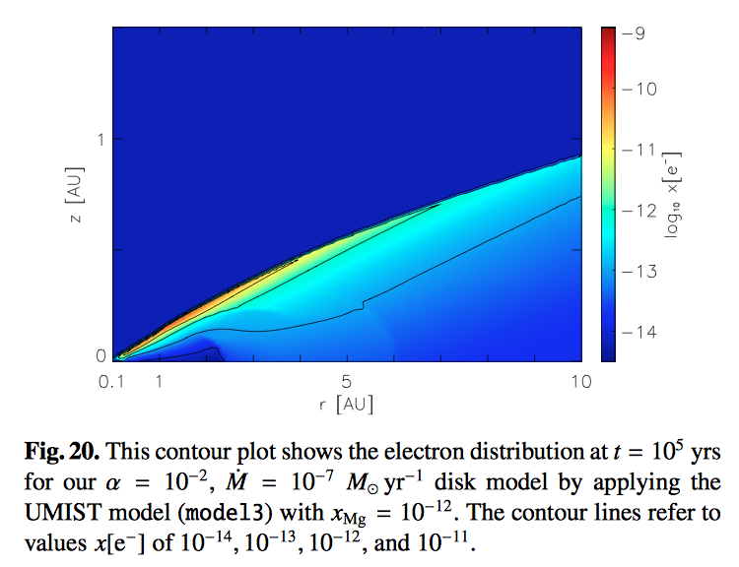
Calculation of
ionization fraction
from Ilgner &
Nelson ‘06
Metal ions and dust grain reactions are both
important factors determining ionization degree

Slide 26
Are cosmic rays shielded from disk? Solar wind
modulates local flux of cosmic rays, do T Tauri stellar
or disk winds have similar effect? (Cleeves et al. ‘13)
Is the microphysics of ionization balance fully
understood? Ionization by electrons accelerated in
MHD turbulence, non-linear relation between current
and electric field strength… (Inutsuka & Sano ’05;
Okuzumi & Inutsuka ‘15)

