Slide 1
Lecture 2
Star and Planet formation
Mechanisms of cloud collapse.
Disk formation.
Giant planet formation
Planet migration

Slide 2
Stars
Planets
~ 530 planets to date:
Notes:
Figure 1 Mass versus semimajor axis for all known objects in the mass range from 10⁻⁴ to 100 M_{J} in orbit around nearby stars or brown dwarfs. Data were compiled from exoplanet.eu, Burgasser et al. (2007) and vlmbinaries.org. Data are represented in four different versions of axis scaling to emphasize different aspects of the parameter space. The yellow region indicates the only region that is clearly devoid of objects based on sensitivities of various surveys. The green region is almost entirely unobserved except in a few cases for extremely young objects (and the Solar System). The gray regions show roughly where direct imaging surveys have placed some constraints on this parameter space, with darkness qualitatively representing completeness

Slide 3
Trapezium in Orion
500 parsecs away.
Massive stars carving out a cavity via radiation and winds.
HST and La Silla
courtesy Prof. Alice Quillen, University of Rochester

Slide 4
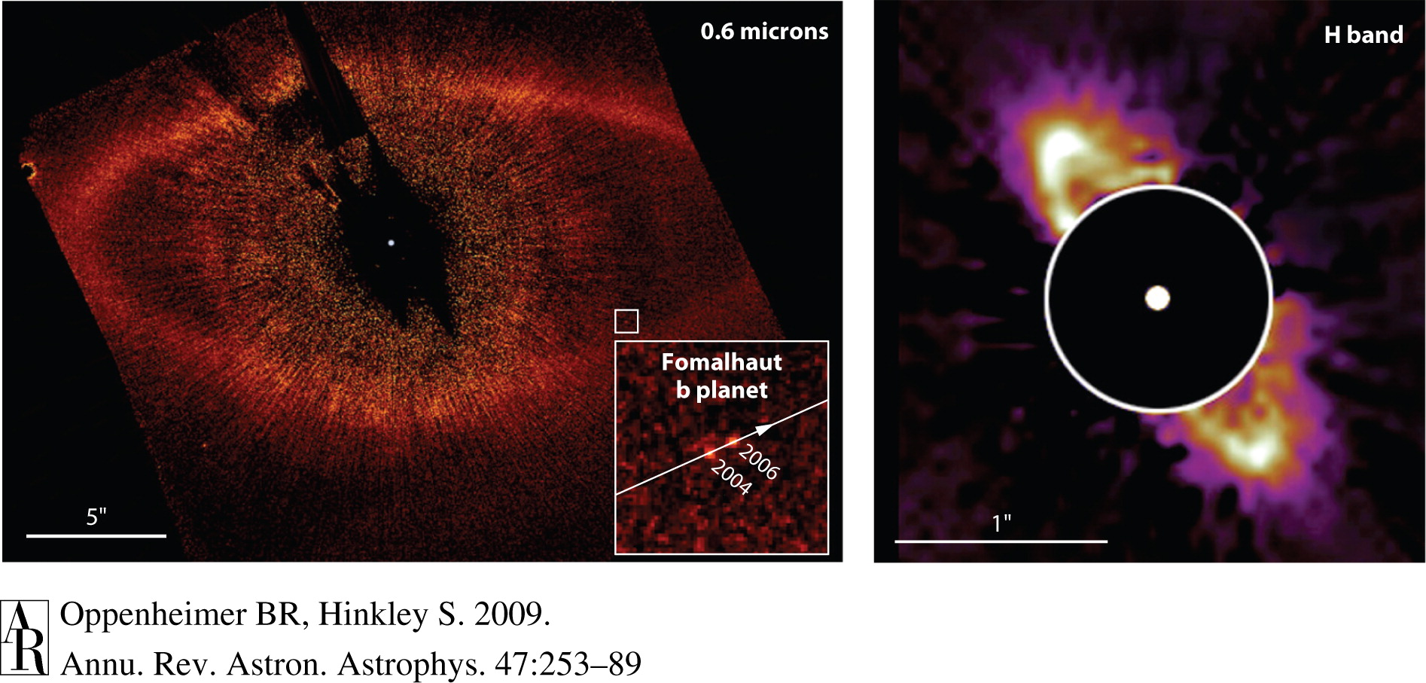
Planets form in disks and remain with leftover debris
Notes:
Images of (left) the ring of debris around Fomalhaut and (right) HR 4796A (left: Hubble image STScl-PRC08-39a; Kalas et al. 2008, courtesty of NASA, ESA, and P. Kalas of University of California, Berkeley; right: Schneider et al. 1999, courtesy of B. Smith, G. Schneider, and NASA).

Slide 5
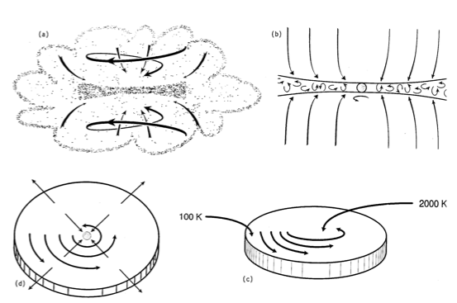
Collapse of clumps in Molecular Clouds and formation of disks
E. Levy

Slide 6
Minimum mass for collapse: Jean’s mass
courtesy Alice Quillen, University of Rochester

Slide 7
courtesy Prof. Alice Quillen, University of Rochester

Slide 9
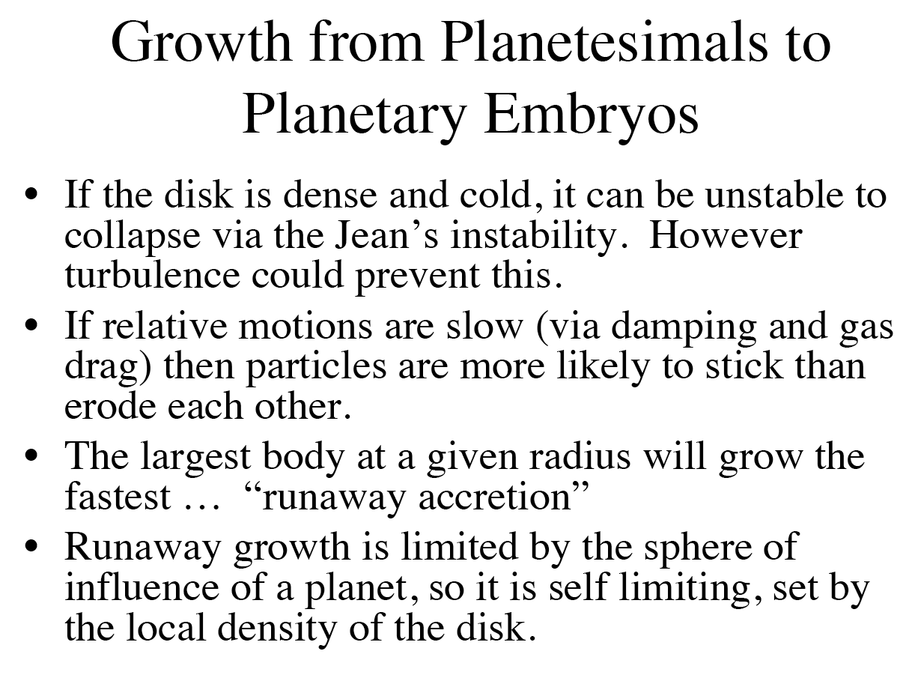
courtesy Alice Quillen, University of Rochester

Slide 10
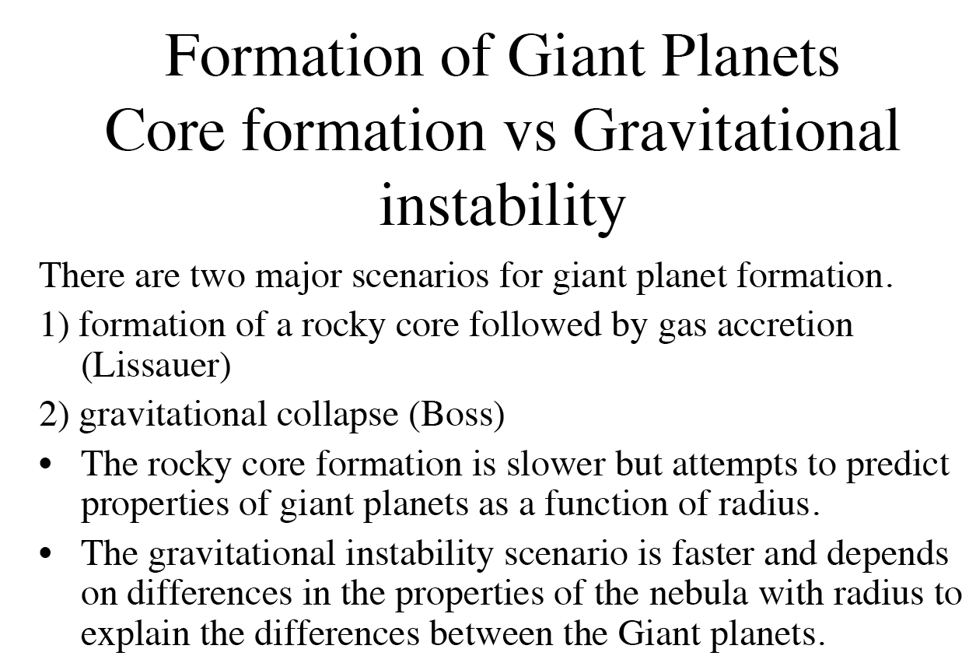
courtesy Alice Quillen, University of Rochester

Slide 11
The core instability model
How do the gas giants acquire their huge envelopes?
escape speed from a growing solid protoplanet with the density of the Earth is
v_{esc} = 11 km/s (M/M⊕)^{1/3}
growing protoplanet gradually acquires a static atmosphere
when v_{esc} >> c, the sound speed, the mass of the atmosphere can exceed the mass of the planet ⇒ instability
in more detail:
energy balance is determined by competition between cooling by radiation and heating by accreting planetesimals
as planetesimal density falls, cooling wins and the accretion of gas runs away until the planet acquires all of the gas in its region of the disk
runaway sets in at about 10-20 M⊕
must occur before protoplanetary gas disk is dispersed
Tremaine

Slide 12
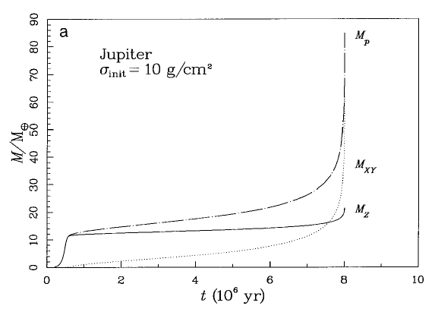
gas runaway
planetesimal runaway growth

Slide 13
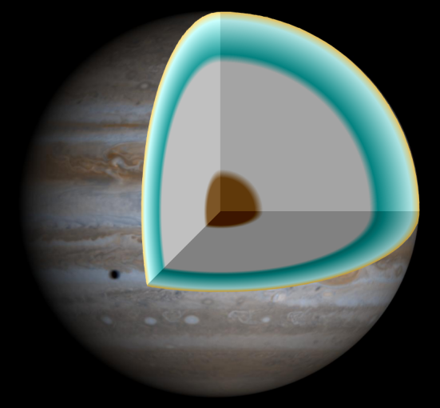
NASA R.J. Hall
Interior models in favor of core accre.

Slide 14
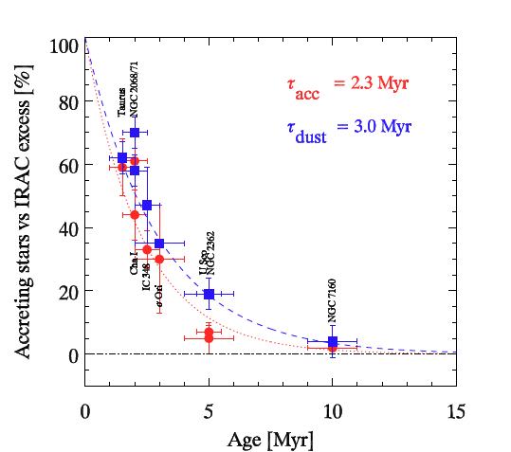
Astronomical constraints from observations of disks around other stars: Gas is largely gone from planet-forming disks by 5 million years (Myr) after disk accretion begins.
VIMOS on VLT
Fedele et al. A&A 2010

Slide 15
Sumi et al. 2010
Notes:
Known exoplanets as a function of mass vs. semimajor axis divided by the snow-line, which is taken to be at asnow= 2.7 AU M/M⊙. As in Figure 8, microlensing planets are indicated by red filled and open circles with error bars (see Section 7.2). OGLE-2007-BLG-368Lb is indicated by the gold-filled open circle. Blue dots represent the planets first detected by transits. The black bars with upward-pointing error bars are the planets detected via the radial velocity. The green and magenta triangles indicate the planets found by timing (including the pulsar planets) and by direct detection, respectively.

Slide 16
Migration
Type I: low mass planet only weakly perturbs the disk
timescale of order Ω⁻¹ (ΣR²/M)(M_{p}/M)
very rapid, ~ 10⁴ years for Jupiter in minimum solar nebula
usually inward
Type II: bigger planet opens a gap in the disk
planet evolves with the disk on the disk’s viscous evolution timescale (acts like a disk particle)
probably ~ 10⁴ - 10⁵ yr timescale
usually inward
Tremaine

Slide 17
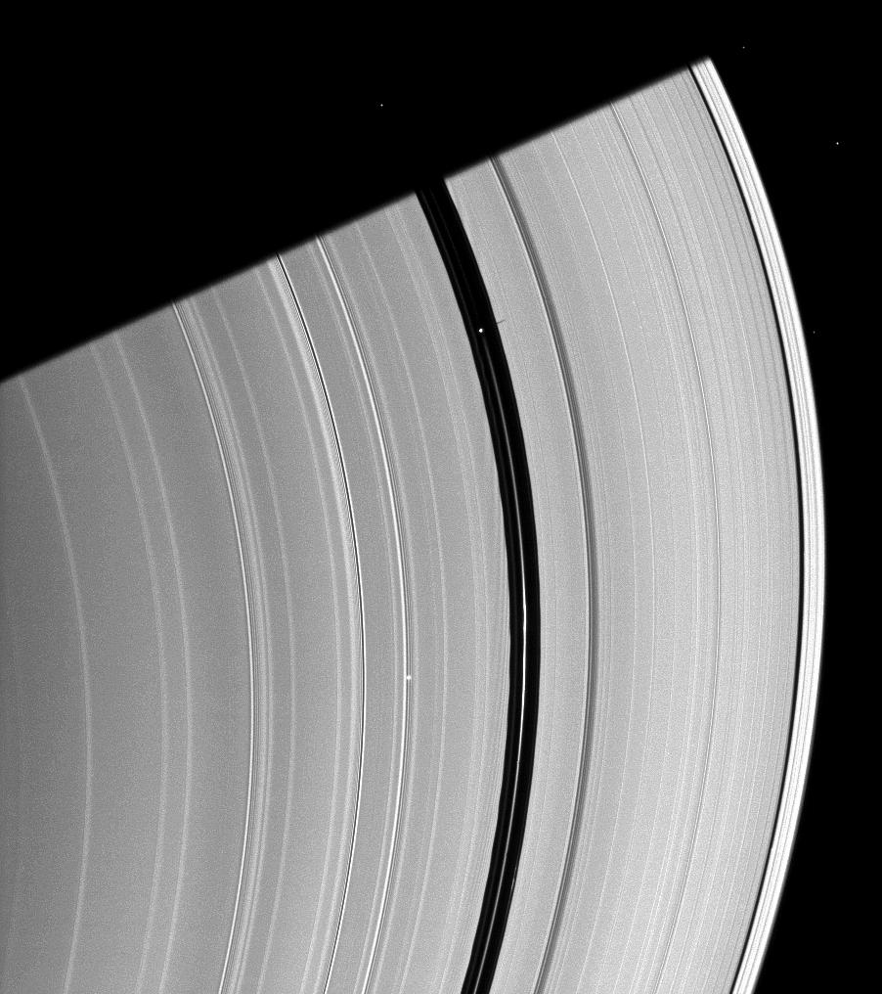
Pan makes a gap in the rings of Saturn.
(Cassini/SSI image)

Slide 18
migration from larger radii offers a plausible way to form giant planets at small radii, but:
why did the migration stop?
why are the planetary semimajor axes distributed over a wide range?
did migration not occur in the solar system?

Slide 19
Way around excessive migration: small planetesimals
Chambers 2006

Slide 20
Mayer et al, 2002.
Science 298 1756.
Bottom panel is
350 years after
top left panel.
Very cold, unstable
disk.

Slide 21
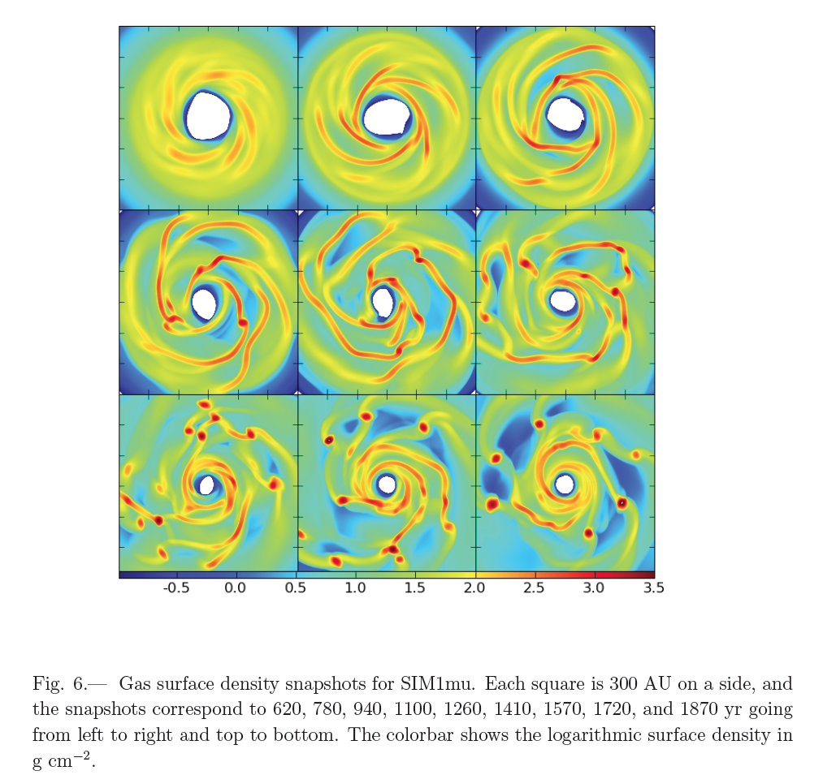
Boley and Durisen 2010

Slide 22
Planet-planet scattering explains the observed eccentricity distribution of exoplanets. Juric and Tremaine, 2008.
Tends to weigh in favor of gas instability

Slide 23
Core Accretion vs gas instability
Test for Jupiter via presence of a core (Juno)
Gas instability
creates a large population of free-floating planets
requires a cold, relatively unstable gas disk
Core accretion
creates planets with high metallicity relative to their star
requires long timescale for core accretion: millions of years.

Slide 24
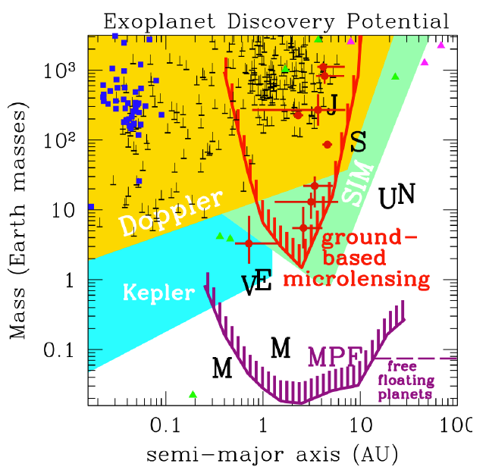
Space-based photometry is more precise than ground-based
David Bennett

Slide 25
Kepler data support core accretion
Uranus/Neptune
Borucki et al 2011.

Slide 26
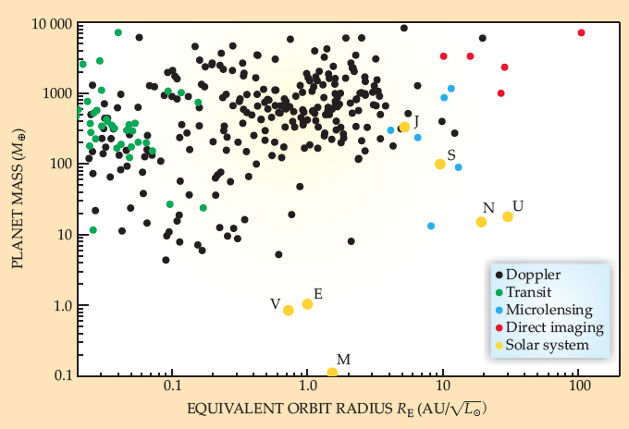
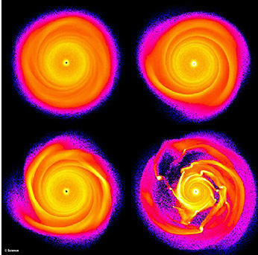
? or ?
Boss

Slide 27
Why is timescale an important problem?
Giant planets occur around > 10% of sun-like stars
Giant planet formation models are in part timescale-driven
direct collapse: very fast (<< 1 Myr), requires cold disk
core accretion: slower, constraint on disk lifetime
Constraining the timescale for formation of Jupiter and Saturn is useful in deciding between the two mechanisms.

Slide 28
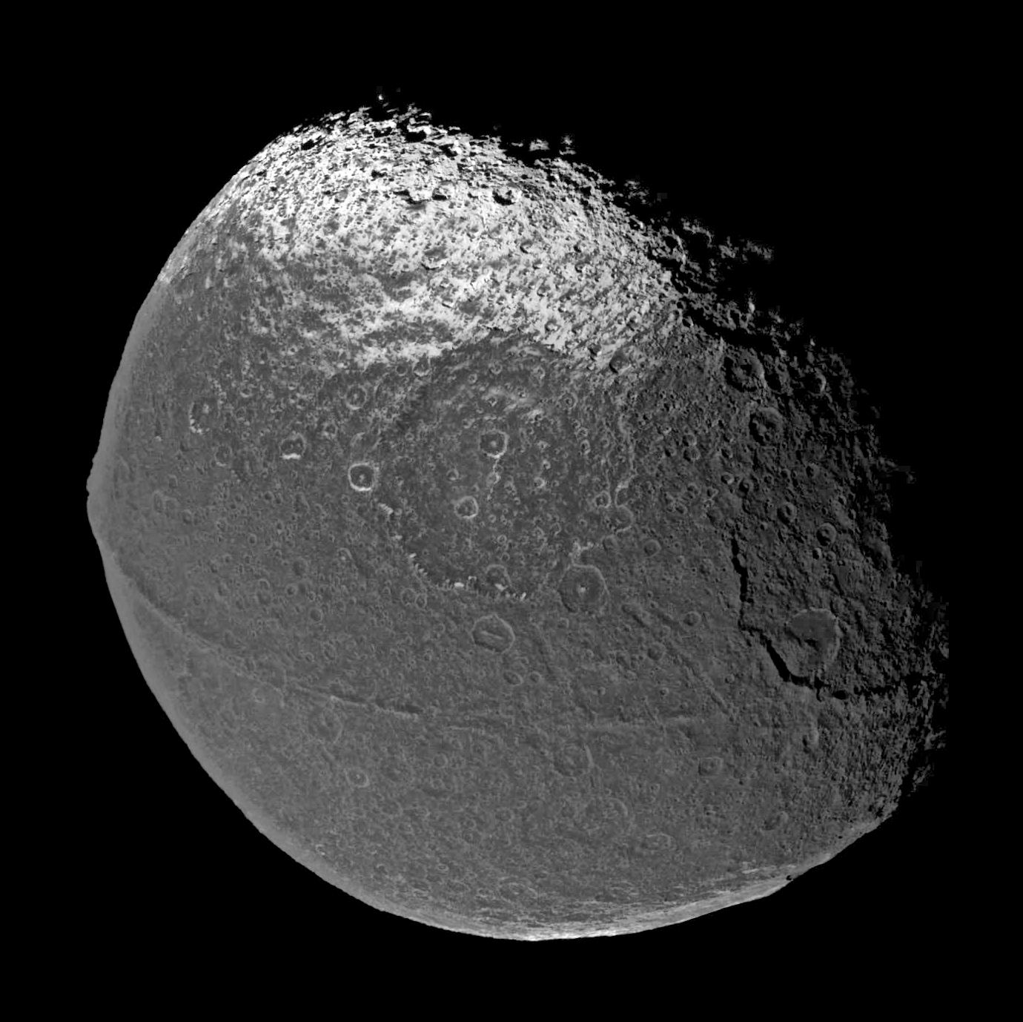
Iapetus provides an absolute timescale for the formation of Saturn.

Slide 29
Require sufficiently high dissipation to reduce rotation period while maintaining its shape.
Two observations to reconcile
The rotation period is synchronous at 79 days
The figure of Iapetus matches the equilibrium shape for ~17 hr period

Slide 30
Three sources of energy for Iapetus:
Accretion: virial theorem
Short-lived radioactivities (aluminum-26, iron-60)
Long-lived radioctivities (uranium, thorium, potassium)
No short-lived radioactivities Some short-lived radioactivities
Castillo et al 2007, 2009

Slide 32
Astronomical constraints from observations of disks around other stars: Gas is largely gone from planet-forming disks by 5 million years (Myr) after disk accretion begins.
VIMOS on VLT
Fedele et al. A&A 2010

Slide 33
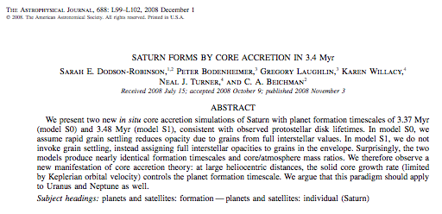

Slide 34
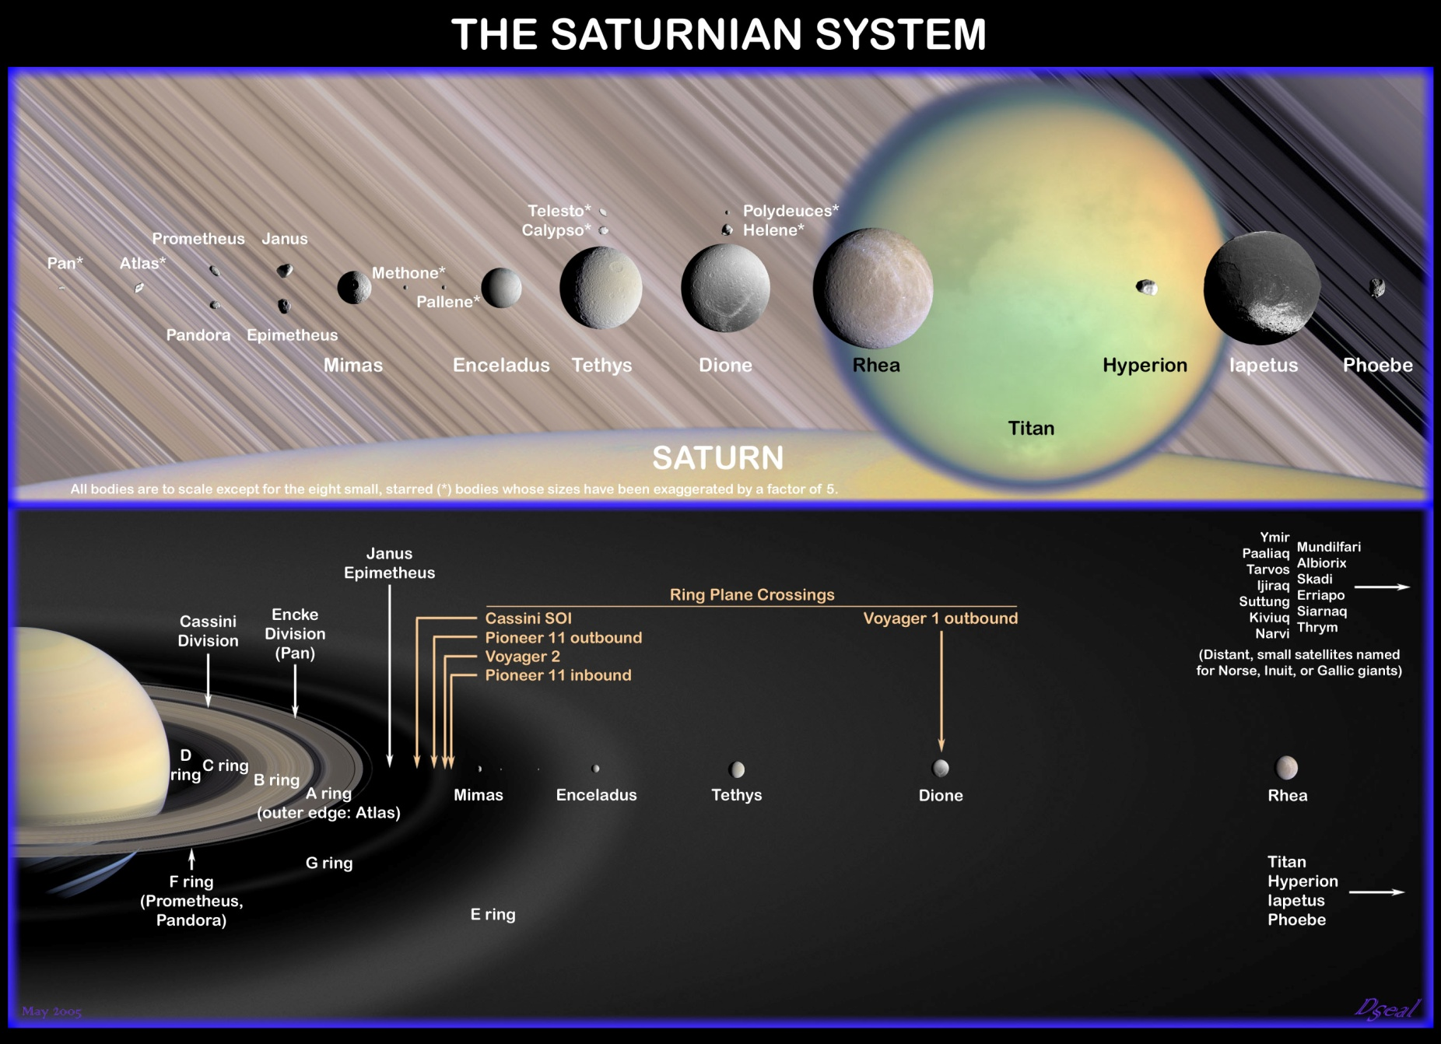
Why Iapetus?

Slide 35
Conclusions
Planets really do form in disks
Giant planets formation from two distinct processes: core formation; disk instability
Both supported, challenged by different data sets
In our own solar system, Saturn formed from core accretion between 3 and 5 million years ago.

